Slide 1
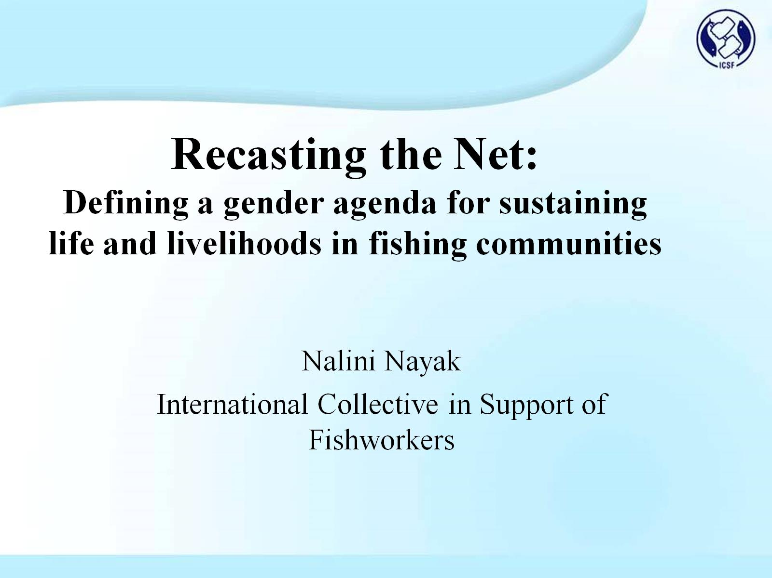
Recasting the Net:
Defining a gender agenda for sustaining life and livelihoods in fishing communities

Slide 2
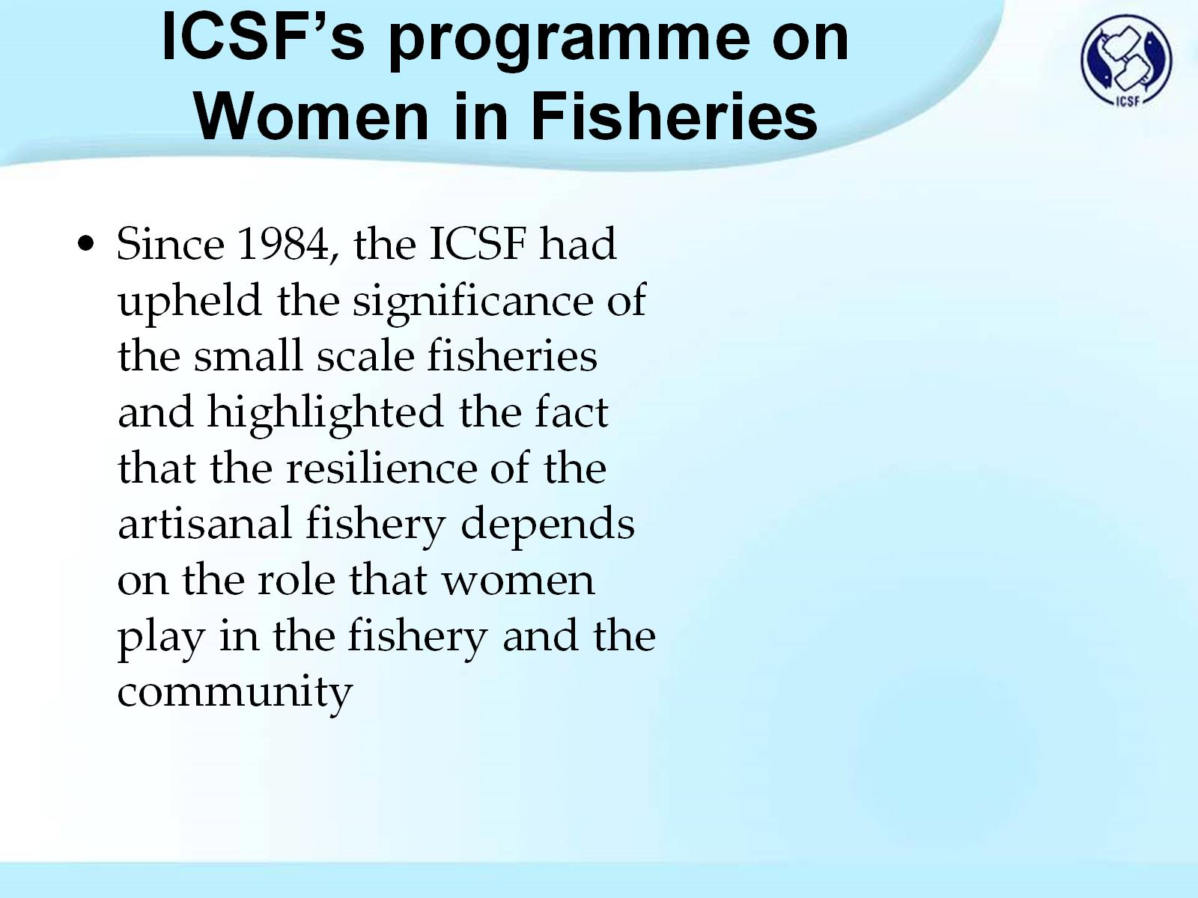
ICSF’s programme on
Women in Fisheries

Slide 3
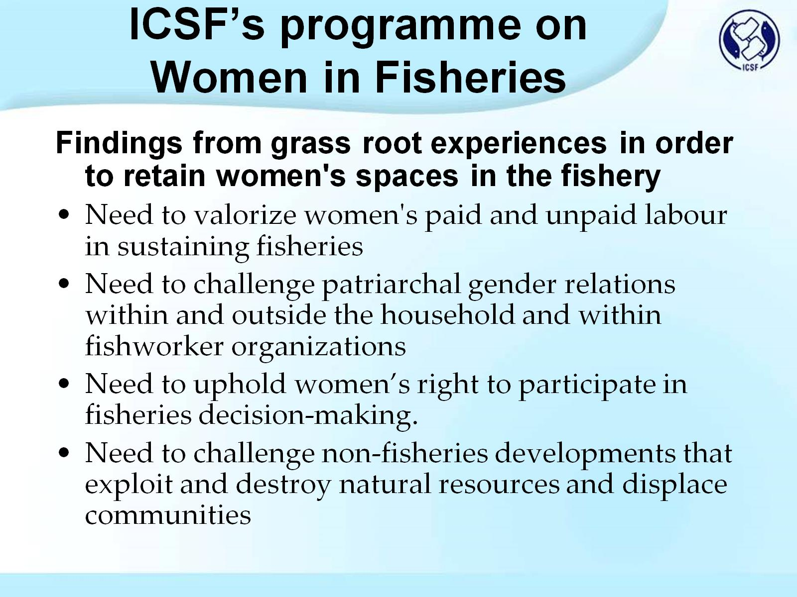
ICSF’s programme on
Women in Fisheries

Slide 4
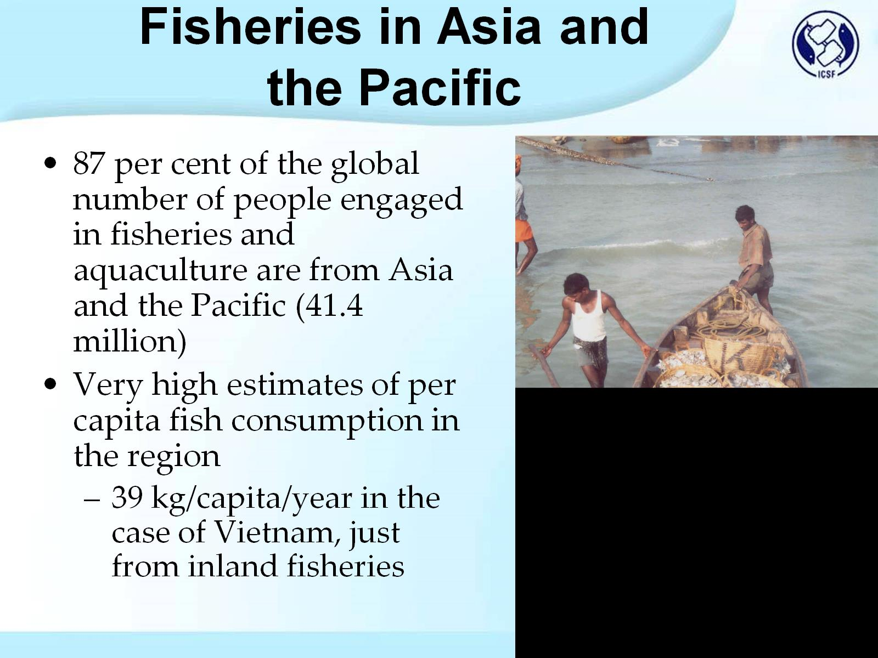
Fisheries in Asia and the Pacific

Slide 5
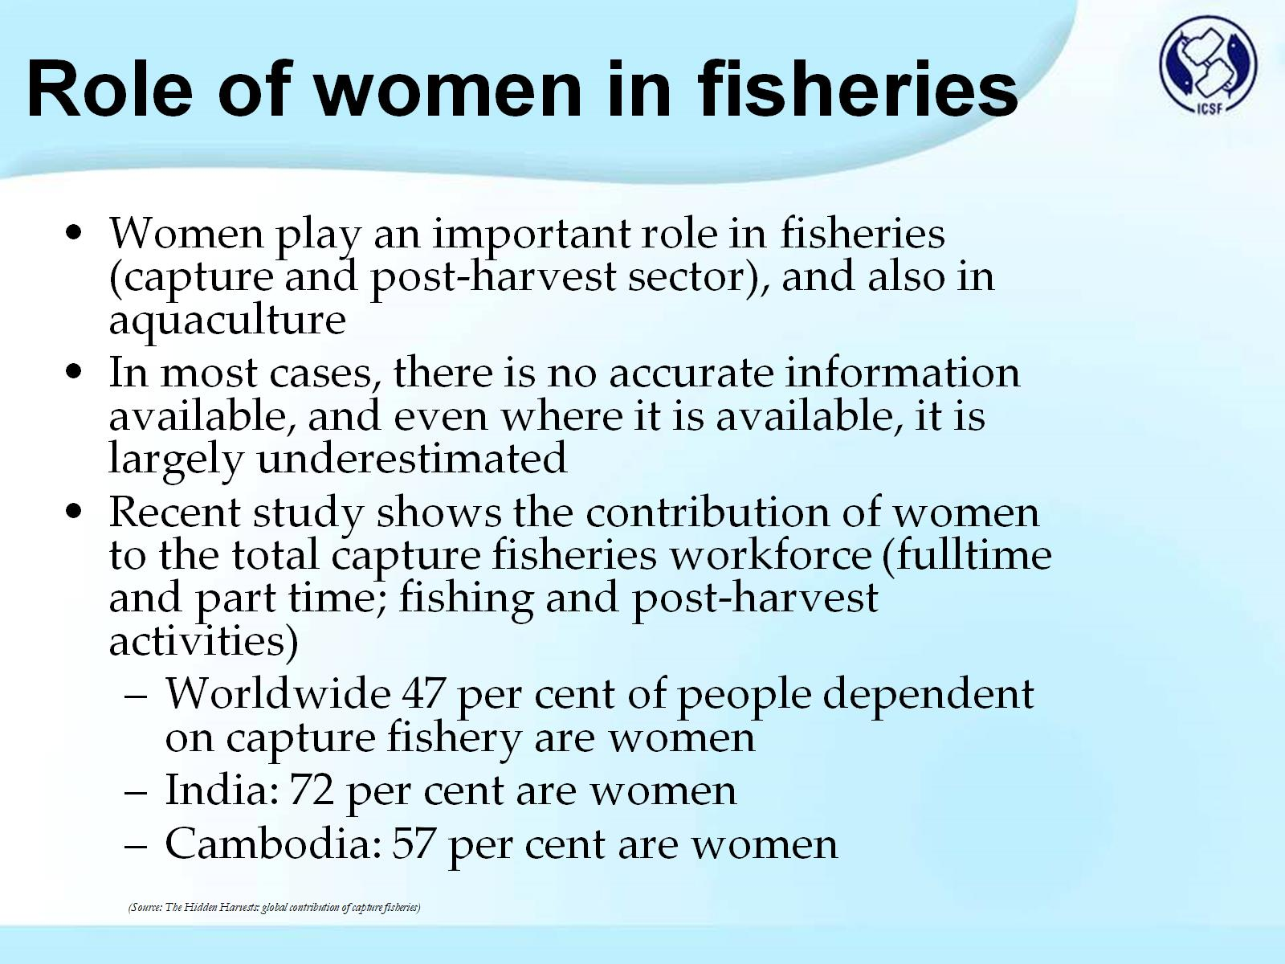
Role of women in fisheries

Slide 6
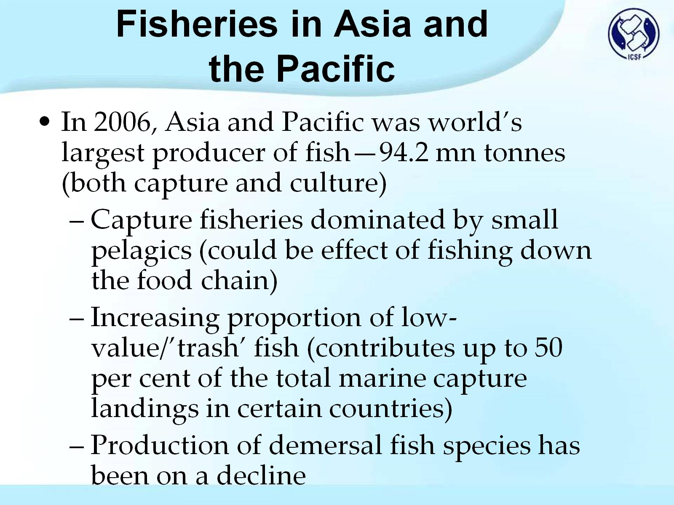
Fisheries in Asia and the Pacific

Slide 7
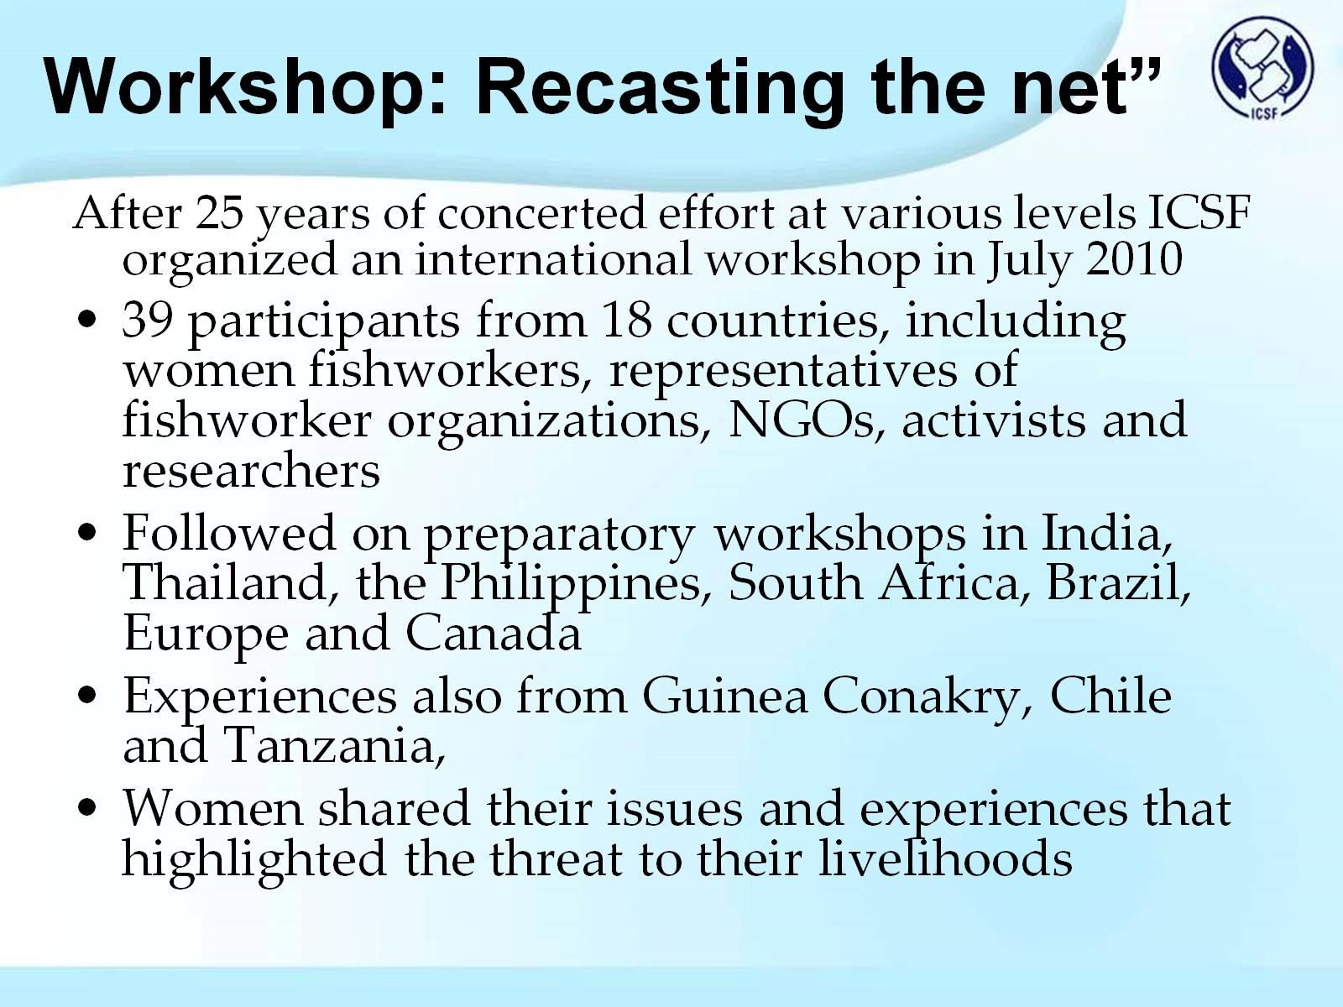
Workshop: Recasting the net”

Slide 8
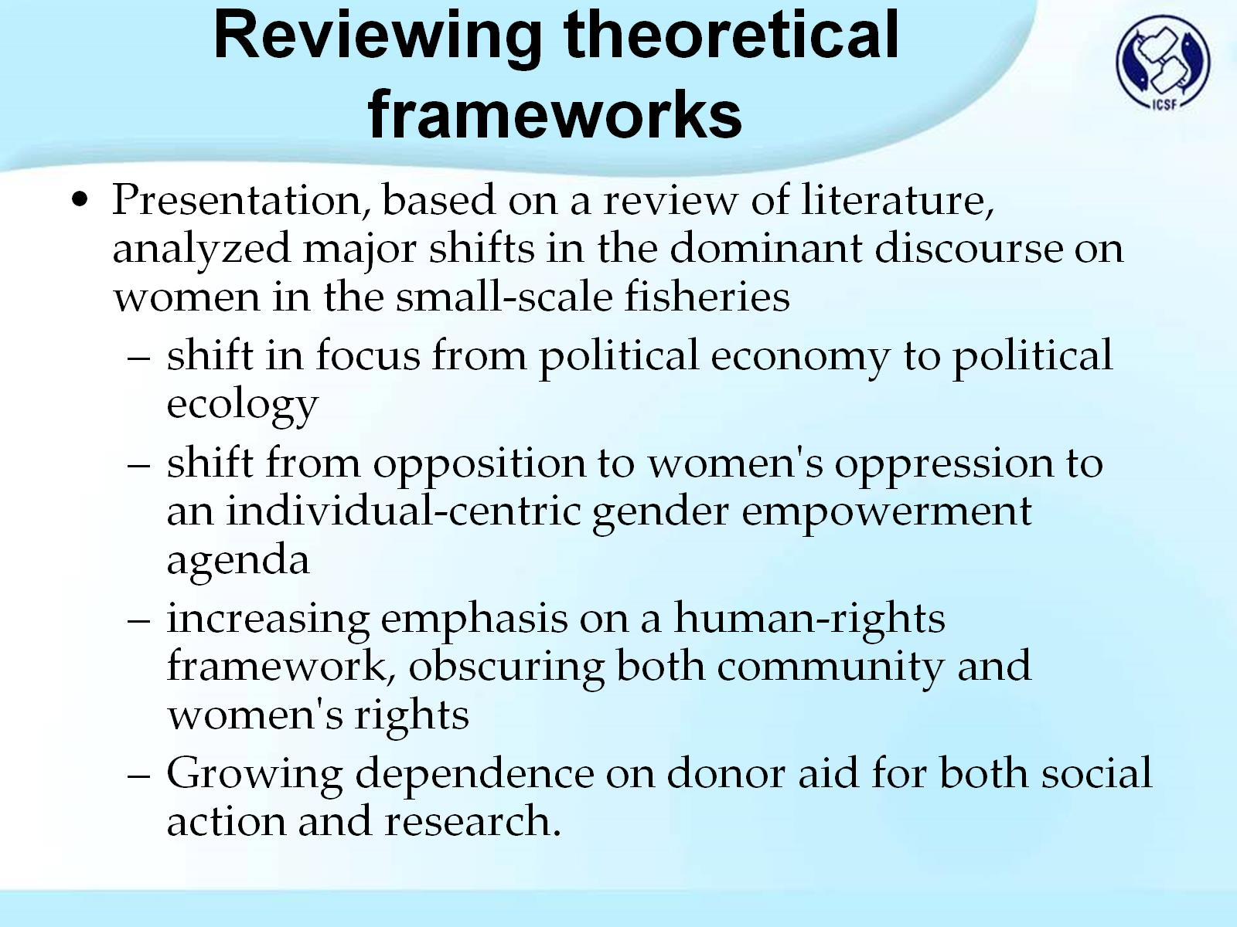
Reviewing theoretical frameworks

Slide 9
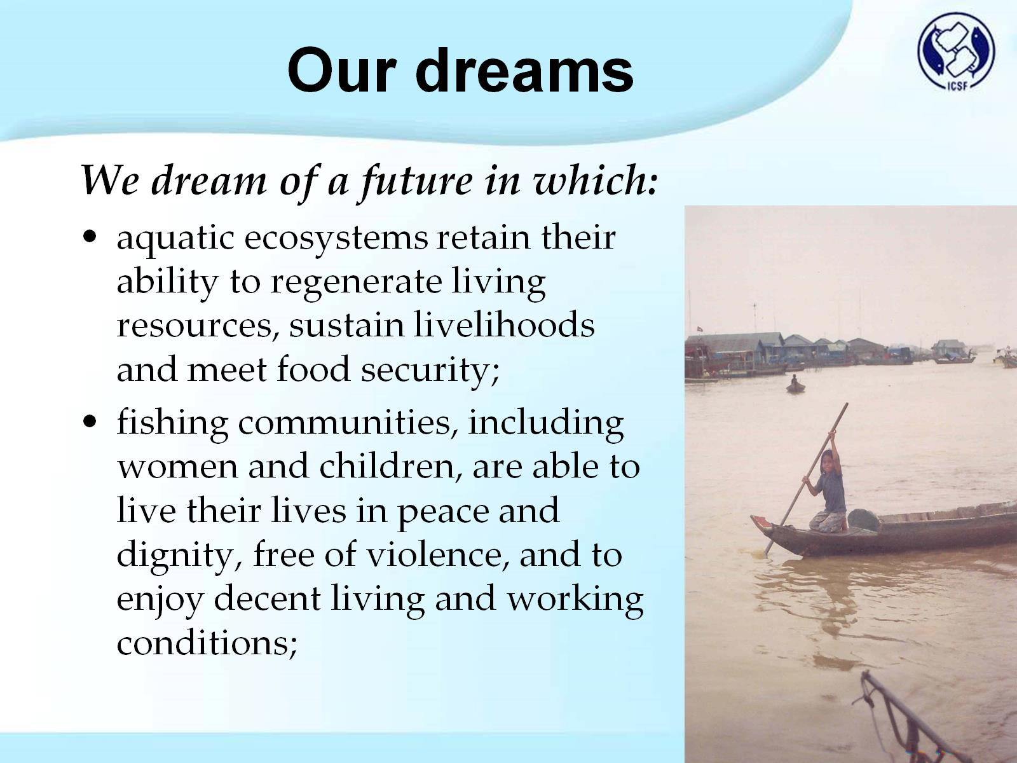
Our dreams

Slide 10
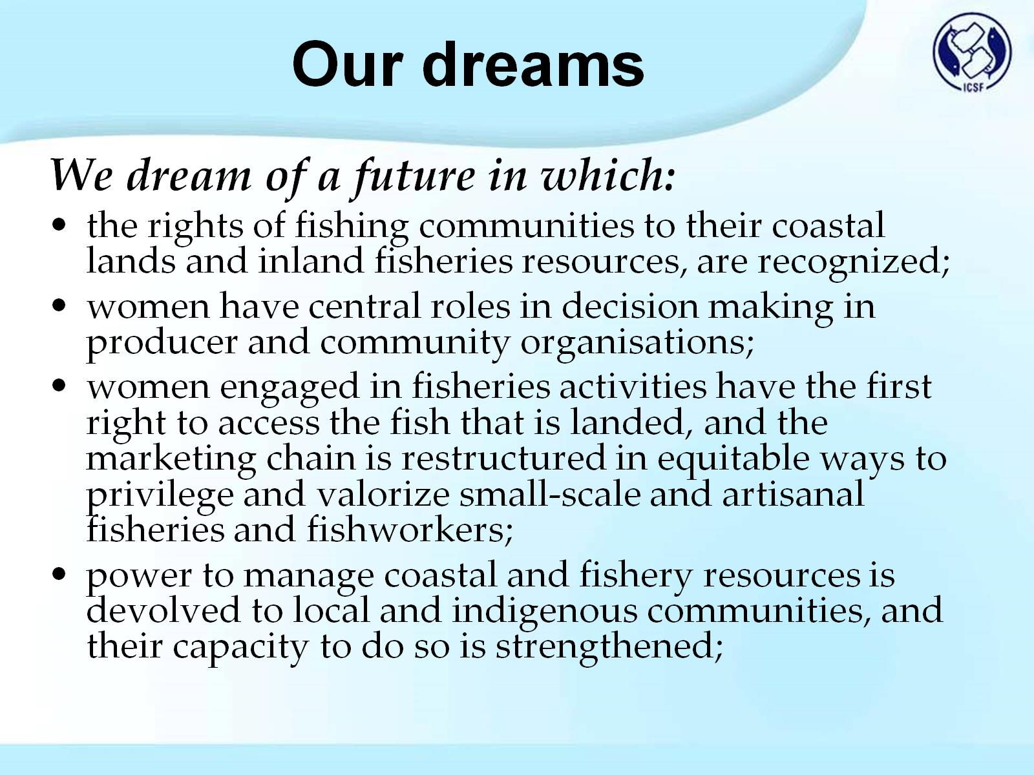
Our dreams

Slide 11
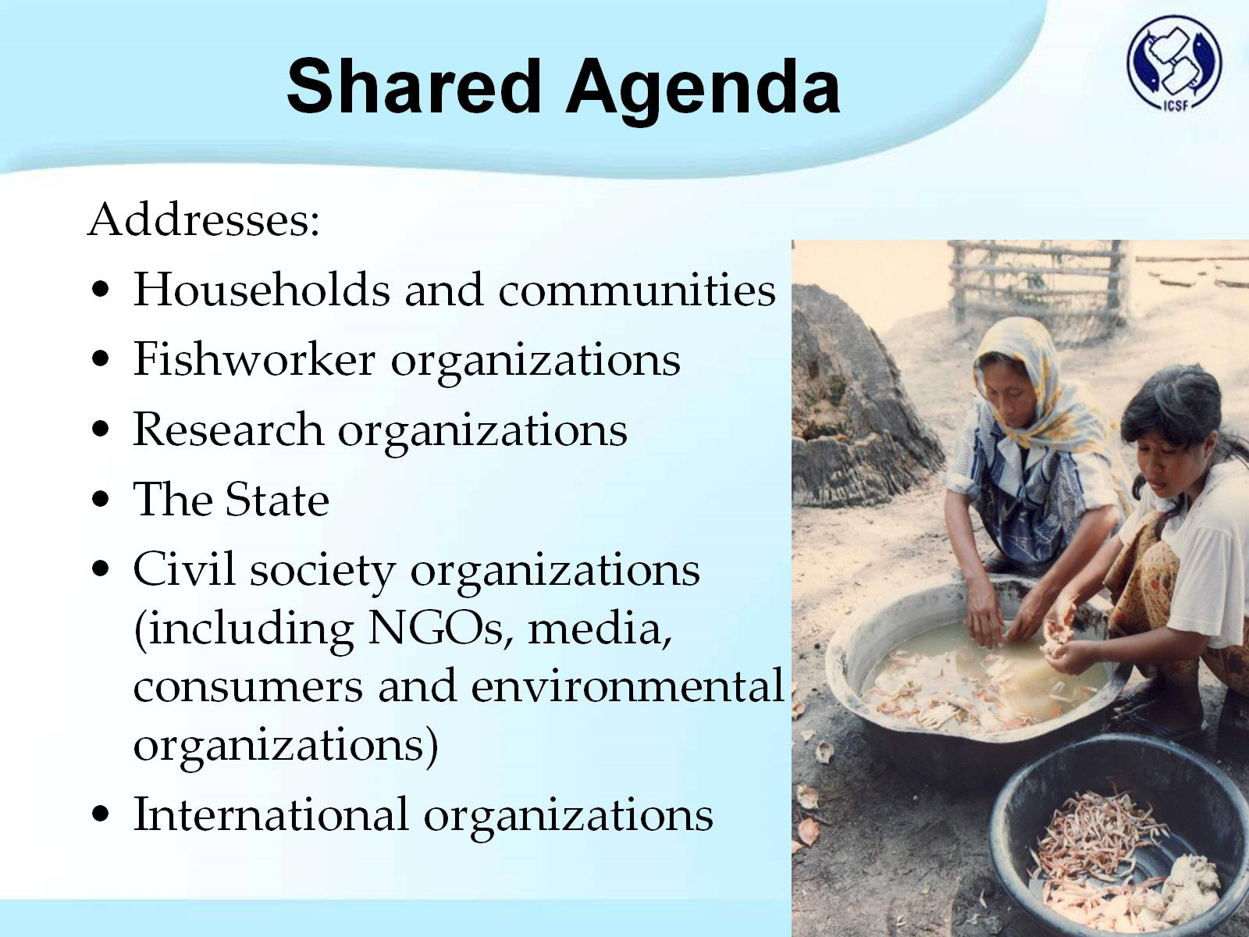
Shared Agenda

Slide 12
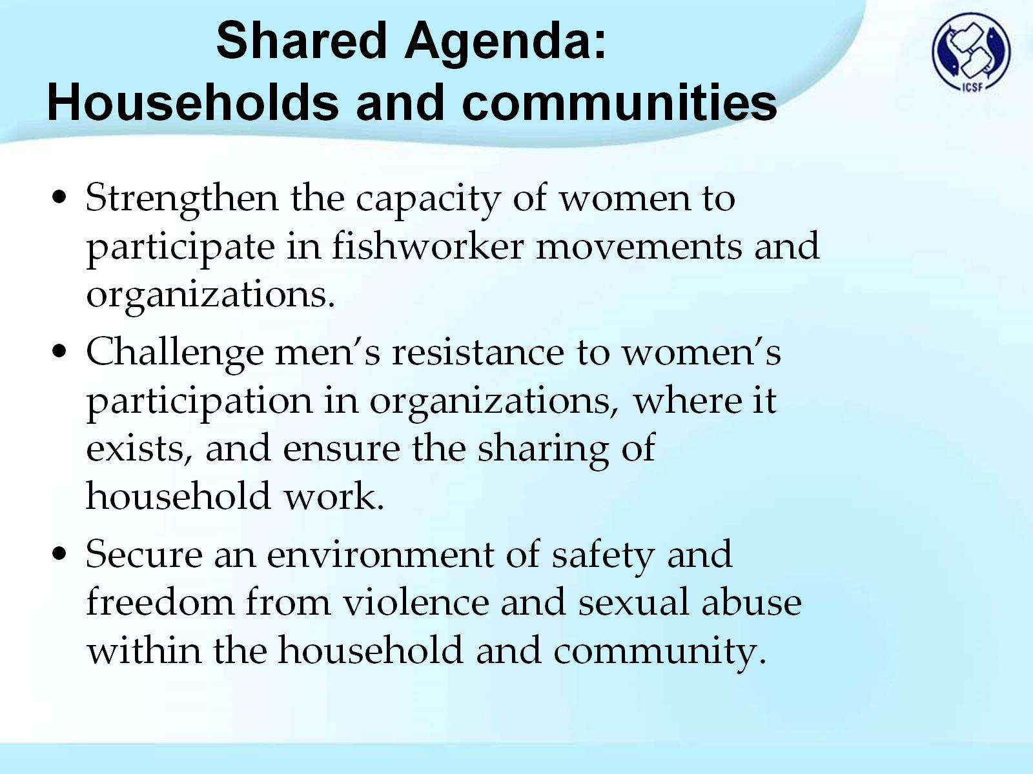
Shared Agenda:
Households and communities

Slide 13
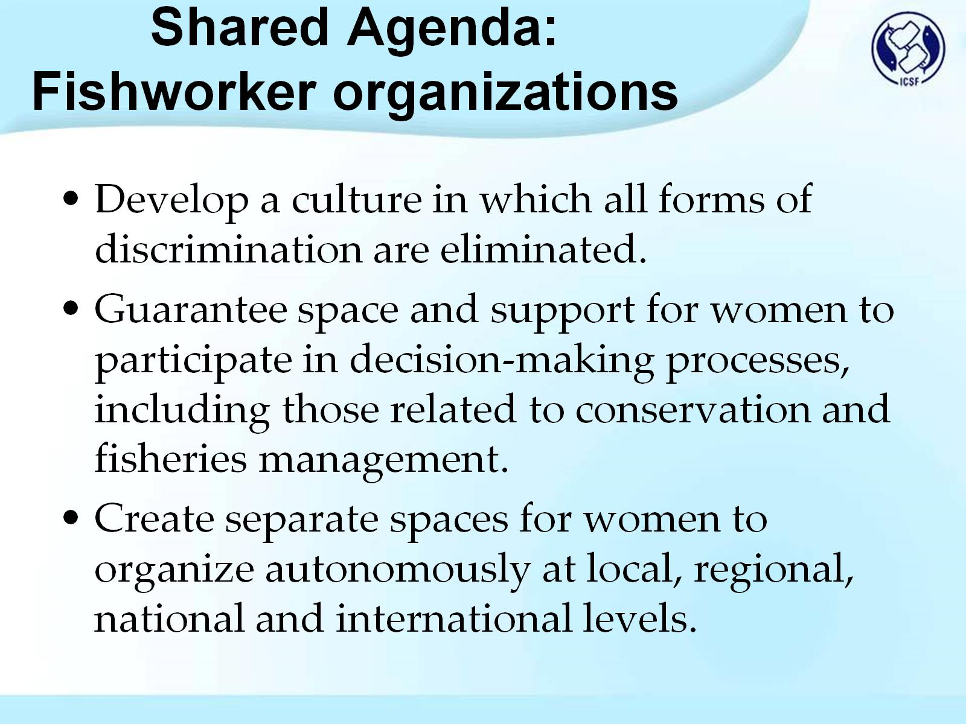
Shared Agenda:
Fishworker organizations

Slide 14
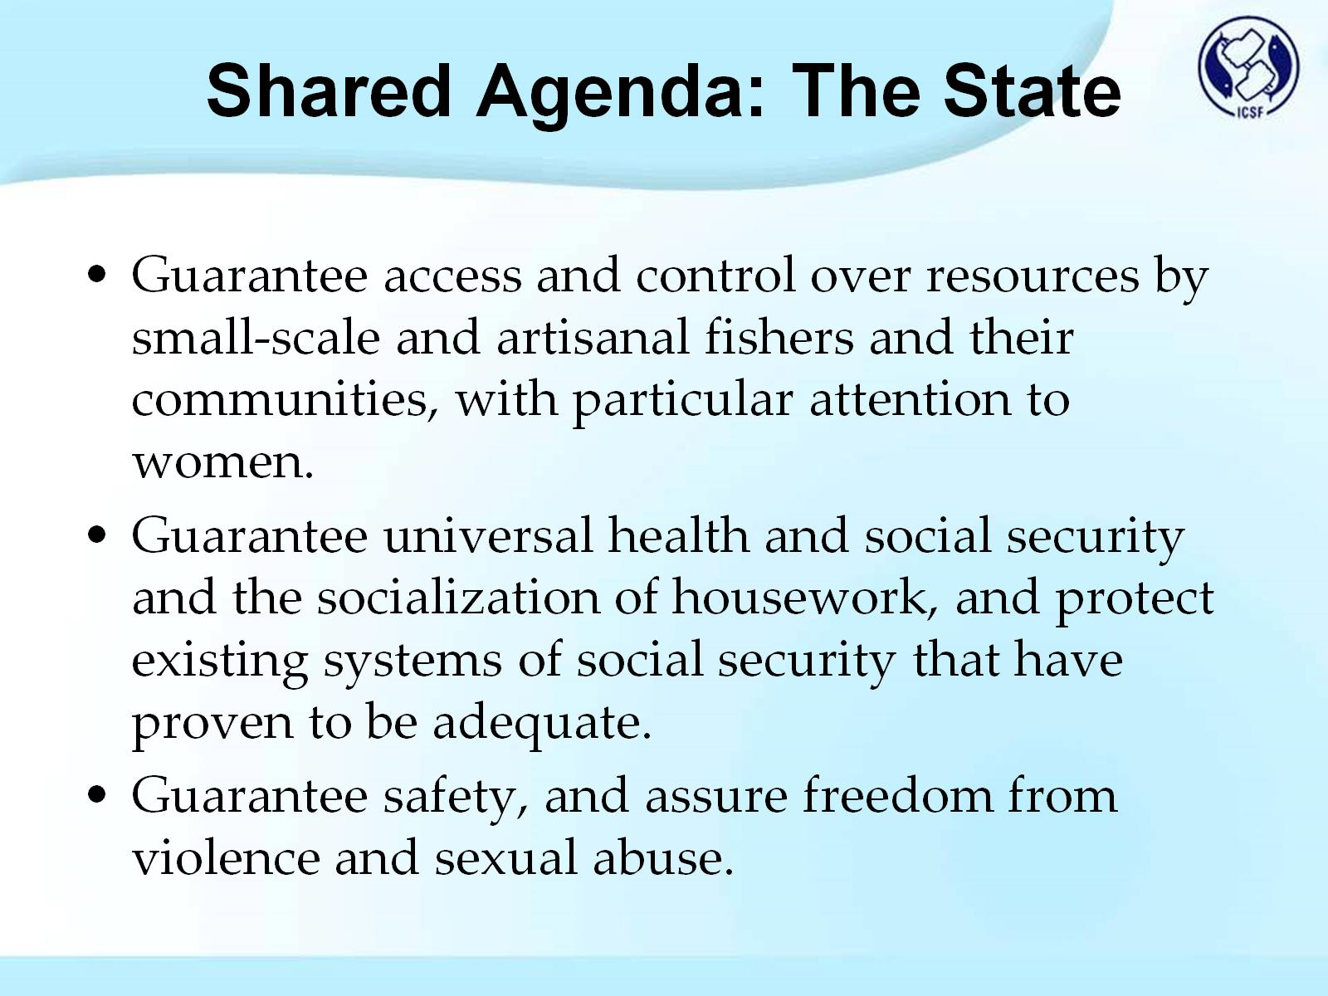
Shared Agenda: The State

Slide 15
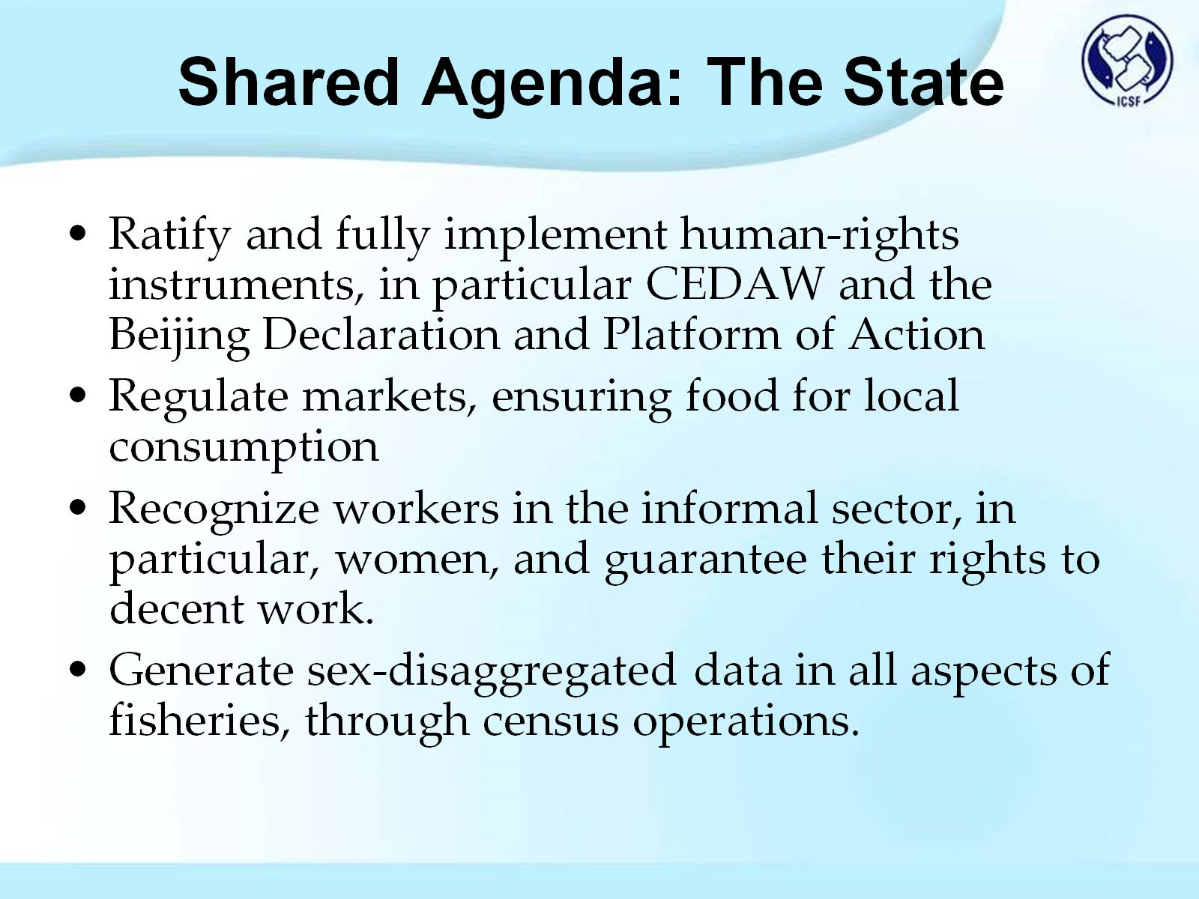
Shared Agenda: The State

Slide 16
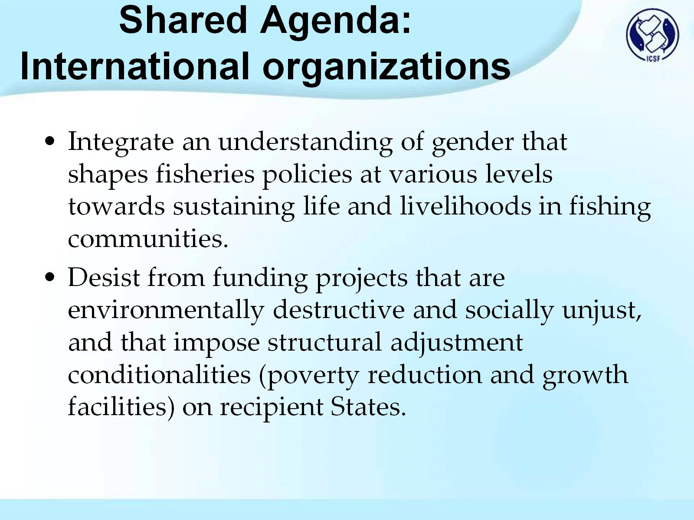
Shared Agenda:
International organizations

Slide 17
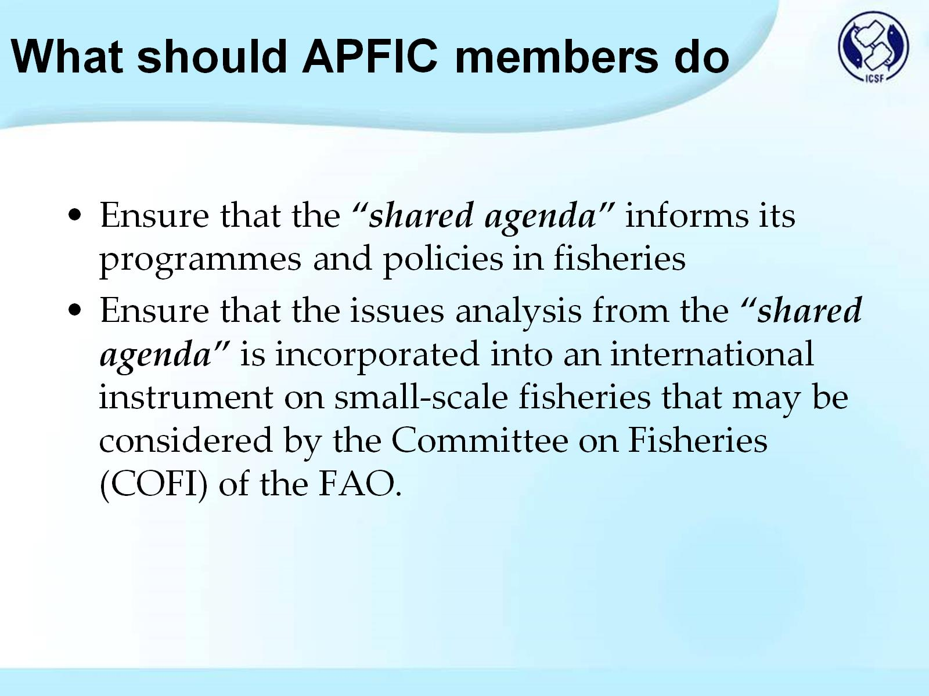
What should APFIC members do

Slide 18
