Slide 1
Challenges of Women in fisheries – THE CASE OF fish vendors of Mumbai

Slide 2
Context

Slide 3
Women Fish Vendors in Mumbai

Slide 4
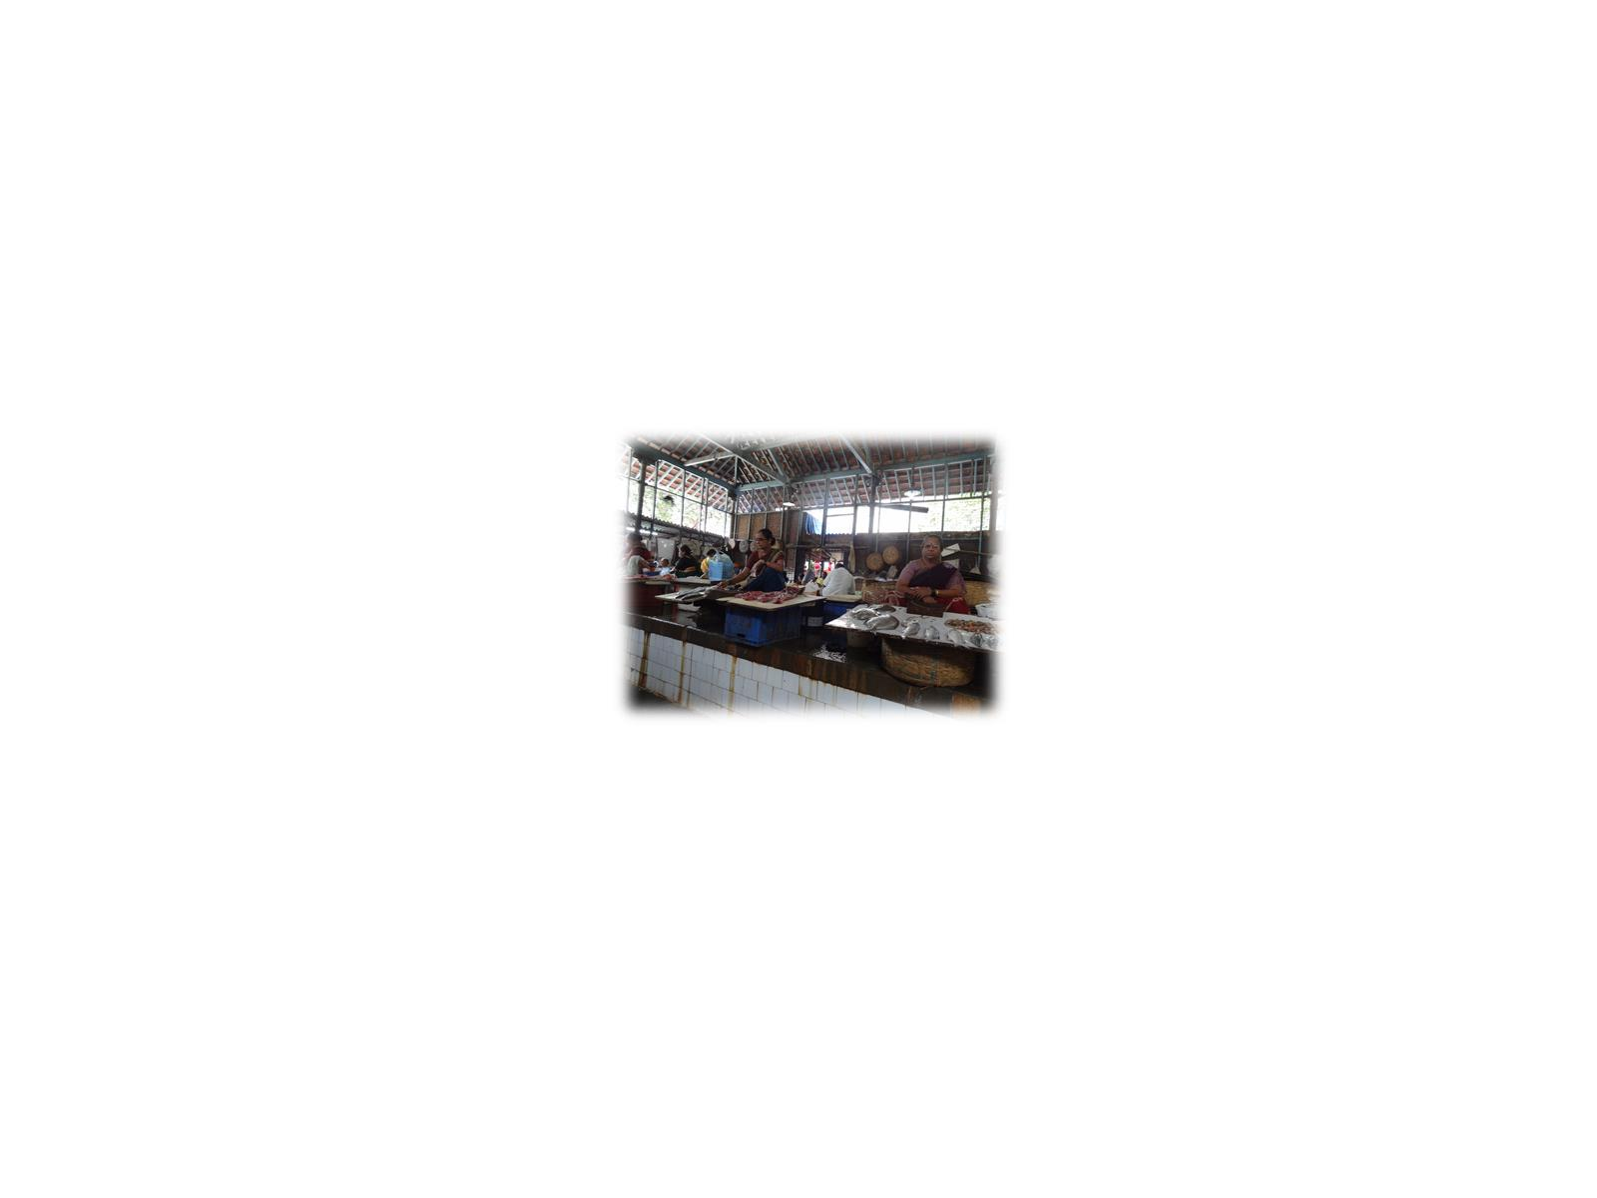

Slide 7
Three major challenges faced by women fish vendors in Mumbai

Slide 8
Access to Fish

Slide 9
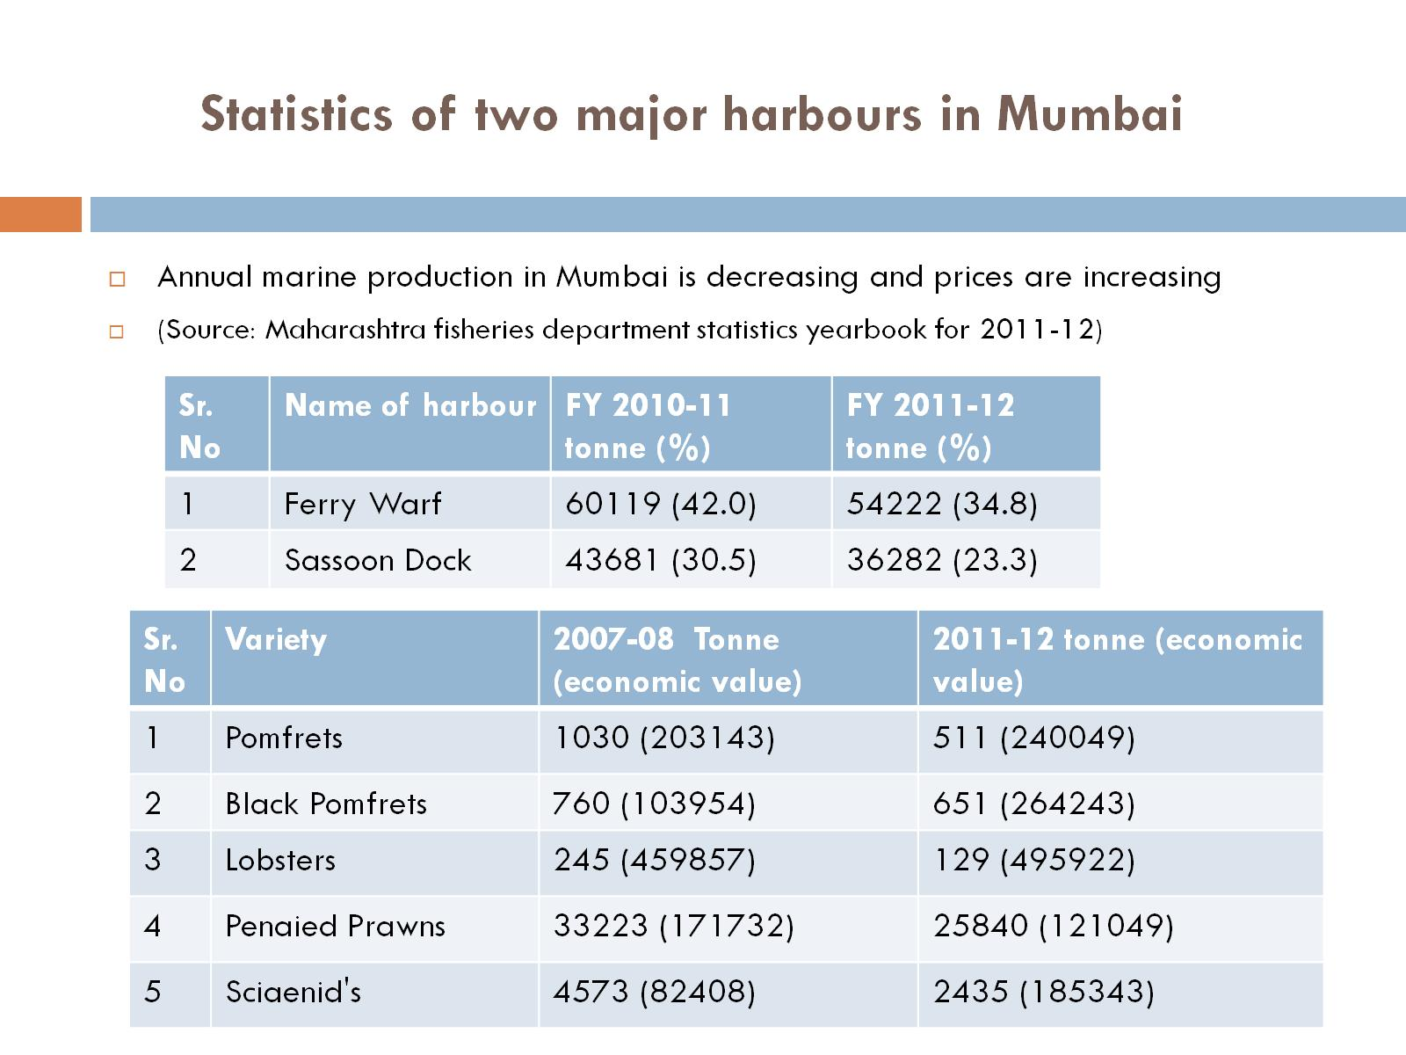
Statistics of two major harbours in Mumbai

Slide 10
Women’s Space in Fisheries

Slide 11
Women in fisheries organizations in Mumbai

Slide 12
State intervention

Slide 13
Needs of women

Slide 14
Follow-up actions

Slide 15
THANK YOU

