Slide 1
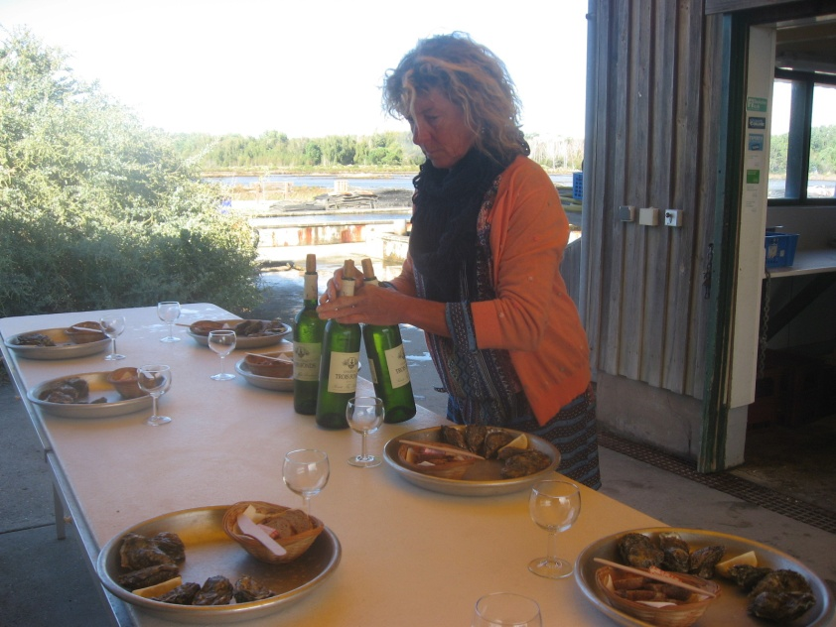
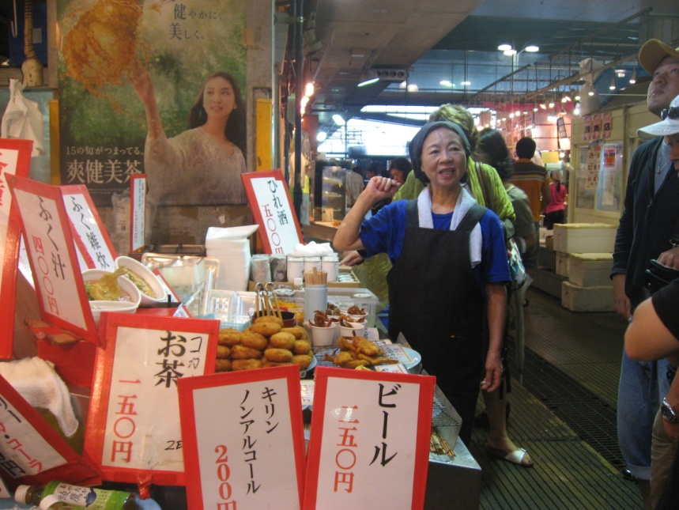
Opportunities and constraints of the SSF Guidelines to address Social Inequality - predominantly from a feminist perspective
Katia Frangoudes, Cornelie Quist, ICSF Members

Slide 2
SSF Guidelines recognized women contribution in 4 domains :
pre harvest, harvest and post harvest activities (freshwaters and marine SSF including shellfish and seaweed) but not aquaculture
gender equity and equality as fundamental for the development process and equal rights and opportunities for women
Promotion of women’s leadership (reference to CEDAW calling for elimination of gender prejudicial customary practices)
Gender sensitive policy making, women’s participation in fisheries organization and equal access to extension services and technical training adapted to women

Slide 3
Some general observations
Terms “women” and “gender” seems to be synonymous for SSFG text
Guidelines try to be inclusive by mentioning often
Women and Men or include women and a specific attention to marginalize and vulnerable groups
Its preface says:
“SSF employ 90% of the world’s capture fishers and fish workers about half are women (…..) and engaged in directly providing food for their household as well in commercial fishing, processing and marketing”

Slide 4
Rapid reading of SSFG with a feminist perspective:
Chapter 1: objective/ No specific mention on women or gender
Only the following can be found:
“these objectives should be achieved through the promotion of human rights-based approach, by empowering SS fishing communities, including both men and women, to participate to decision making processes, and assume responsibilities for sustainable use of fishing resources…”

Slide 5
Chapter 3: Guiding principles
Recognition of dignity and human rights of all individuals, equality and not discrimination, participation and inclusion, etc… are present
2 references to women
Gender equity and equality is fundamental to any development and recognizing the vital role of women in SSF, equal rights and opportunities should be promoted
Respect to culture: “encouraging women’s leadership” and with the support of CEDAW: “elimination of prejudicial gender based customary practices”

Slide 6
Part II Responsible fisheries and sustainable development: Gender Equality (ch. 8)
References to strategies
Gender Mainstreaming
Elaboration of policies and legislation to challenge discrimination against women and achievement of equality in SSF development
From feminist perspective the text calls to
Secure women equal participation in decision making for policies directed towards SSF
Support women participation in fisheries organizations
By asking states to adopt specific measures to address discrimination against women to guarantee women and their organization participation to the monitoring of their implementation”

Slide 7
More…
Women tenure, participation in fisheries management, social development, employment and decent work and women’s role in the post-harvest chain
States should institute measures that aim to eliminate violence and to protect women exposed to such violence in SSF communities And ensure access to justice for victims of violence, abuse, etc… including within the household and the community” (very clear)

Slide 8
Part III (ch. 10 and 11) make reference to:
gender sensitive policies, production of gender disaggregated data, designing of gender sensitive interventions, gender sensitive indicators for monitoring purposes
Ch. 12 Capacity and development
Speaks about enabling “women to organize autonomously at various levels on issues of particular relevance to them and equitable participation of women in representative structures in small scale fisheries sub-sector along the entire value chain
Ch.13 Implementation support and monitoring
States and all parties should secure “the effective dissemination of information on gender and women’s role in SSF subsector and to highlight steps that need to be taken to improve women’s status and their work”.

Slide 9
Analysis of the Guidelines with a Feminist perspective
Specific chapter on Gender Equality can be seen as strength and weakness
But
Gender Equality could get more power if it was cut crossing objective as CSOs claimed but government decided differently
And as a consequence
Many references to women in others chapters were cutting (ex. Climate change and disasters)

Slide 10
Some limits
Promotion of human rights approach but difficult to be implemented in SSF development without a a transformative outlook aiming to end social injustice and inequality
Little information is available on the implementation of such objective no any reference to social analysis necessary to facilitate the implementation
- No definition of what is gender issues
- No mention on the impact of unequal power relations between women and men in SSF development and on the wellbeing of the communities

Slide 11
A gender perspective of SSF should take to account
A transformative approach aiming to understand the roots and causes of gender injustice and inequality including patriarchal norms
SSFG responds with: gender mainstreaming, data based on gender, etc… notions difficult to understand or realize
instead to promote social majors changes within the sector…

Slide 12
Guidelines speaks about
“vulnerable and marginal groups” and promote an inclusive approach
But these groups are targets of social welfare than agents of changes
Can the inclusive approach guaranty equal benefits of policies or programs ?
Ex. women organization are marginalize within the sector and often subject of patronizing attitudes making difficult the decision making on issues that concern their live, livelihoods or communities.

Slide 13
The volunteer basis of the SSFG raised the following questions:
1. How States will implement the Human rights and gender equality approach fundamental for SSF development?
2. How states will implement women equality when experiences show that it is a sensitive issue usually facing resistance and it is never a priority?
3. How vulnerable and marginalize groups will be identified by all actors of the sector in participatory approach “so that the voices of women and men are heard” if the actors lacks organizations and leaders

Slide 14
Solutions ?
Support women and marginalize groups to build autonomous organizations with the objective to promote a human rights based approach to the SSF sector (role of CSOs, scientists?, others)
And
Act within the decision making process for an action plan for implementation of SSFG focusing on transformative changes for equitable, gender just and SSF sustainable development.

Slide 15
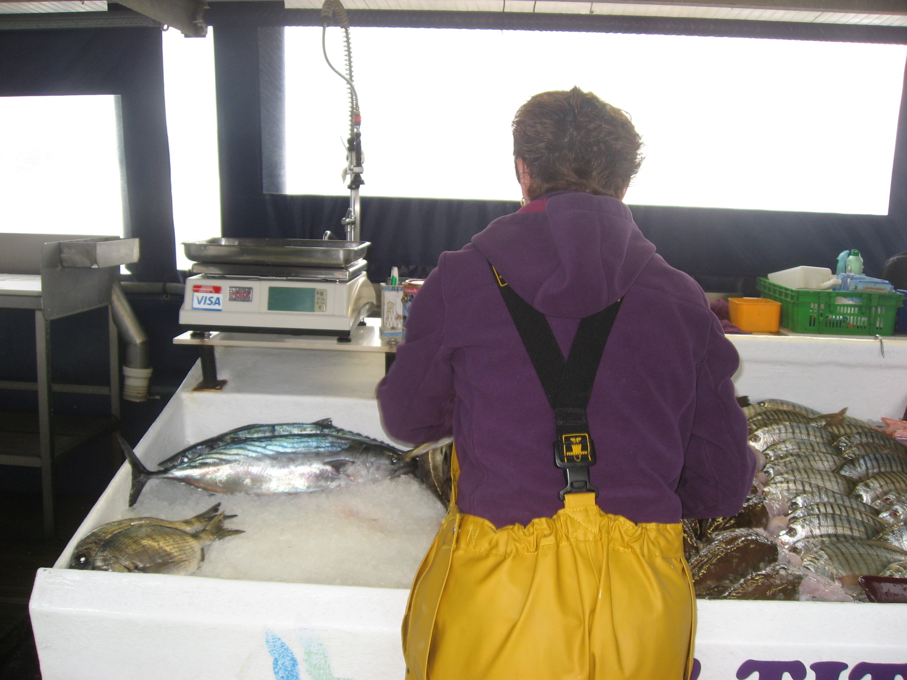
Thanks

