Slide 1
25 Years of Work: Connecting with Fishing Communities for a Sustainable Future

Slide 2
Documentation

Slide 3
Process and Purpose

Slide 4
Documentation as an Art

Slide 5
Documentation Themes

Slide 6
WinISIS database

Slide 7
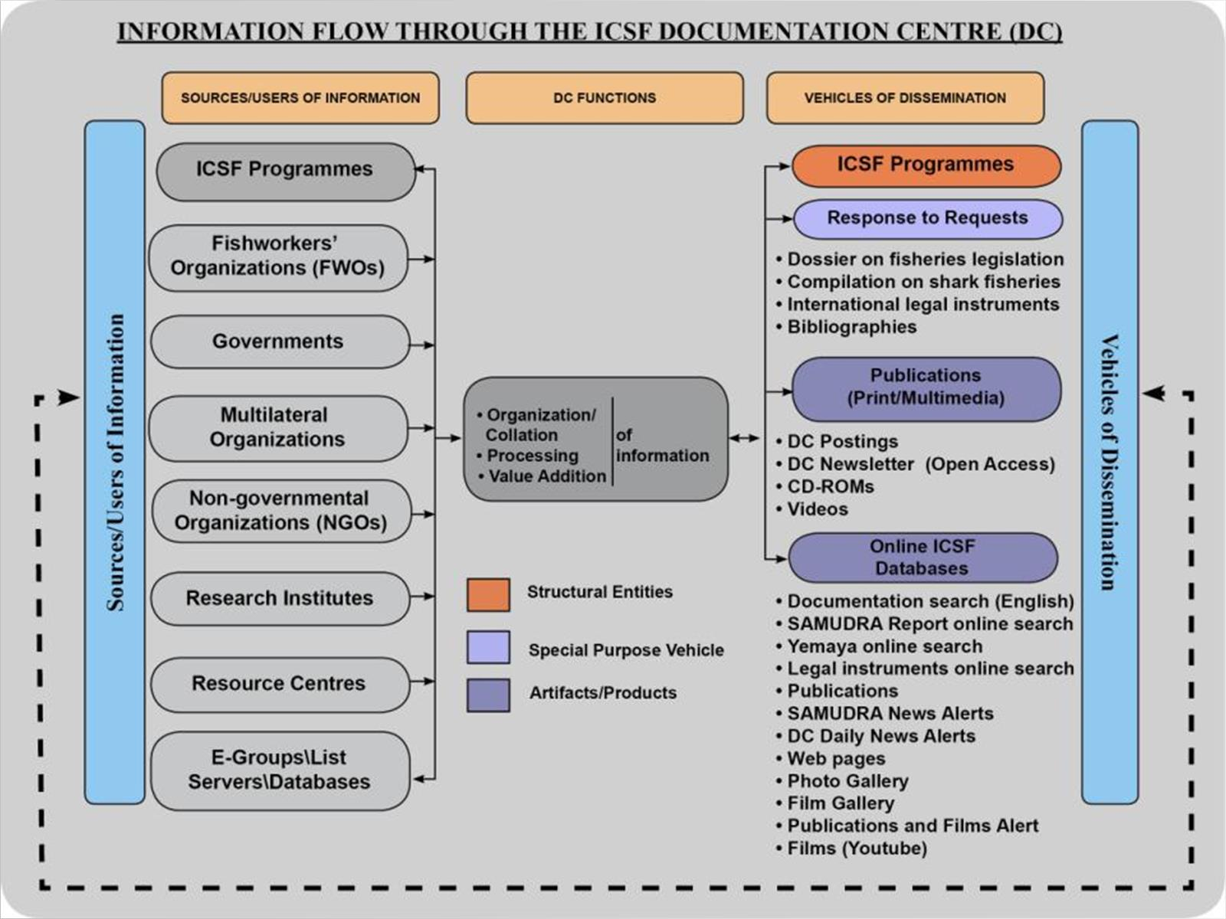

Slide 8
Information Packages

Slide 9
Information Packages (cont..)

Slide 10
Information Packages (cont..)

Slide 11
Information Packages (cont..)

Slide 12
Information Packages (cont..)

Slide 13
Information Packages (cont..)

Slide 14
Support through www

Slide 15
Support through www (cont..)

Slide 16
Support Through www and youtube

Slide 17
Pathways and Platforms

Slide 18
Pathways and Platforms

Slide 19
Challenges

Slide 20
Way Forward

Slide 21
ICSF Website

Slide 22
Thank you

