Slide 1
Social Issues: Just an Afterthought or a Crucial Part of a Solution for a Sustainable Future?
Sebastian Mathew
International Collective in Support of Fishworkers (ICSF)
20th Anniversary
of the Code of Conduct for Responsible Fisheries
8-9 October, Vigo, Spain
Cape Town, South Africa/MDT

Slide 2
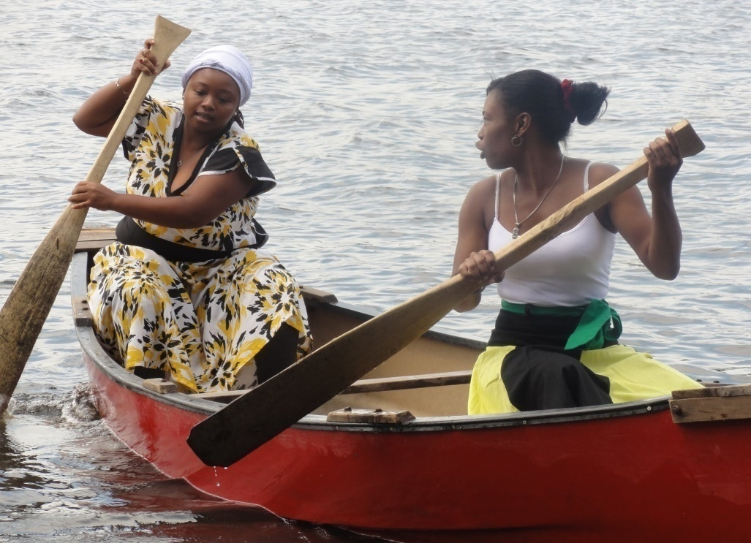
What are social issues?
Problems that prevent bringing benefits to people (benefits such as food security and nutrition security) and
Problems that prevent improving conditions of people (e.g. improving: working conditions and living conditions of women, men and children; wages, shares; access to housing, health, public services; access to social protection; access to resources and access to markets)
Honduras/COOPESOLIDAR R.L.

Slide 3
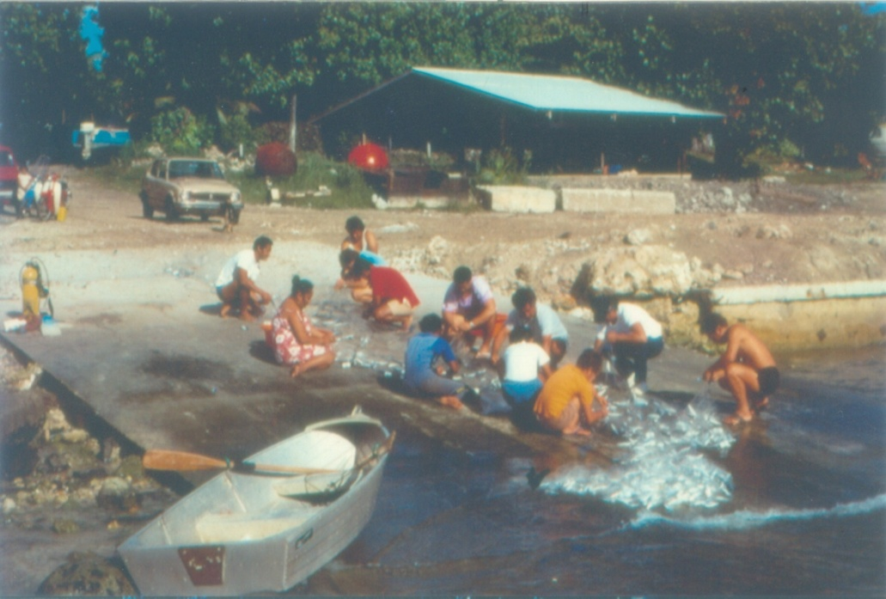
Social Dimension: 1945 FAO Conference (First Session, Quebec)
fishers and shore workers are in the low-income group of labour, more attention should be given to helping them improve their general well-being
Undertake studies on…problems of collective bargaining and labour organization, recruitment, social security, employment under "lay systems" or fixed wages, living conditions and adequacy of income, insurance laws, credit unions, and cooperatives
South Pacific Islands/ICSF

Slide 4
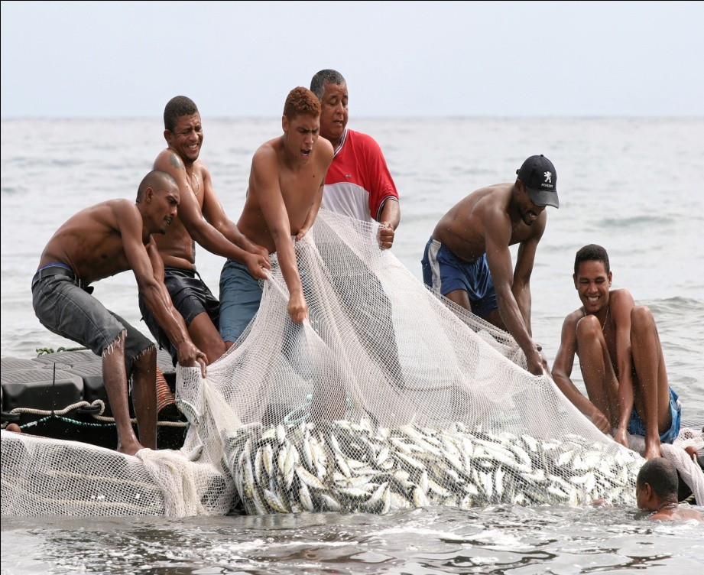
Social Dimension: 1982 UN Convention on the Law of the Sea
Codification and progressive development of the law of the sea to contribute to…promote the economic and social advancement of all people of the world… (Preamble)
Every State shall effectively exercise its jurisdiction and control in administrative, technical and social matters over ships flying its flag (include: labour conditions, safety of life at sea, etc)
Seychelles/ CHRISTEL GRIMAUD

Slide 5
Social Dimension: 1995 CCRF
Recognizes the social importance of fisheries and the interests of all those concerned with the fishery sector (Introduction to the Code)
Establish principles for responsible fishing and fisheries activities taking, inter alia, into account all their social aspects (Objectives)
Promote the contribution of fisheries to food security, giving priority to the nutritional needs of local communities (Objectives)

Slide 6
Social Dimension 2: 1995 CCRF
Bring social benefits (promote availability of fishery resources for present and future generations; sustainable utilization of fisheries resources; maintain nutritional value of fish; promote diversification of income and diet; rural communities to be supported by responsible aquaculture)
Improve social conditions (consultation and effective participation in decision-making; recognition to the traditional practices, needs and interests of indigenous people and local fishing communities; provide safe, healthy and fair working and living conditions; protect rights of fishers and fishworkers to a secure and just livelihood; enhance education and skills of fishers; ensure safety of all fishing vessels; respect crew entitlement to repatriation; respect rights of coastal communities and their customary practices in relation to coastal resources)

Slide 7
Social Dimension 3: 1995 CCRF
Prevent adverse social impacts and address social concerns
Trade policies, programmes and practices should not result in negative social impacts
Livelihoods of local communities and their access to fishing grounds are not negatively affected by aquaculture
Minimize social consequences of water extraction, land use, discharge of effluents, use of drugs and chemicals, and other aquaculture principles
Promotion of international fish trade should not adversely impact the nutritional rights and needs of people

Slide 8
What are the Social Issues in Fisheries? 2014 SSF Guidelines
Poor visibility and recognition of the already important role of small-scale fisheries (half of global fish catches; two-thirds of catches destined for direct human consumption; employ 90% of the world’s capture fishers and fishworkers)
Conflicts with large-scale fishing operations
Competition with sectors such as tourism, agriculture, energy, mining, industry and infrastructure development that are economically and politically more powerful
Overexploitation of resources and threats to habitats and ecosystems
Pollution, environmental degradation, climate change impacts and natural and man-made disasters
Poor enjoyment of human rights and secure tenure rights due to various impeding factors

Slide 9
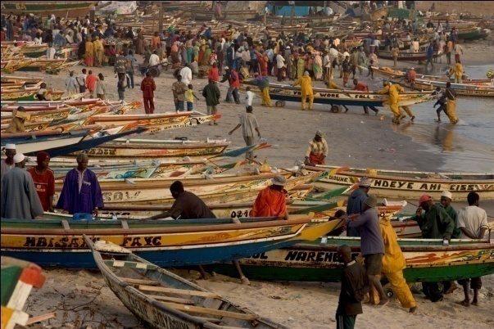
Objectives of 2014 SSF Guidelines
Enhance the contribution of small-scale fisheries to global food security
Contribute to the equitable development of small-scale fishing communities and poverty eradication
Enhance awareness about small-scale fisheries
Provide guidance for responsible and sustainable SSF
Senegal/ J F Hellio

Slide 10
SSF Guidelines: Human Rights-based Approach
The objectives of the SSF Guidelines to be achieved through the promotion of a human rights-based approach, based on international human rights standards, by empowering fishing communities to defend their human rights and tenure rights, especially to benefit the vulnerable and marginalized groups and women (creating conditions whereby everyone may enjoy his/her economic, social and cultural rights, as well as civil and political rights and freedoms)

Slide 11
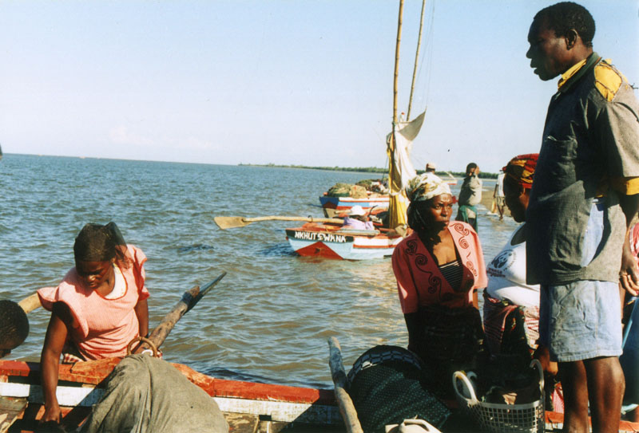
How to Effectively Address Social Issues in Fisheries?
Implement the SSF Guidelines
Implement the Tenure Guidelines
Implement the Right to Food Guidelines
Ratify and implement all relevant ILO instruments including the Work in Fishing Convention, 2007
Mozambique/Cornelie Quist

Slide 12
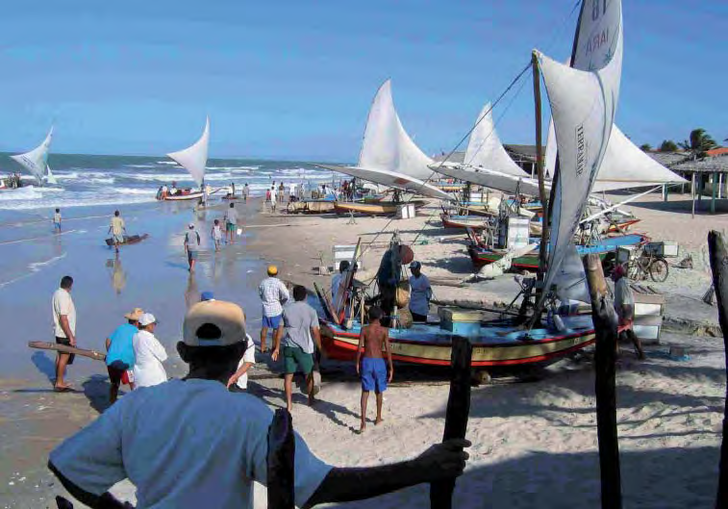
Conclusion: Solution for a Sustainable Future
Addressing social issues is an important pillar in realizing responsible fisheries and is vital in achieving sustainable development
Addressing social issues is important to prevent crime, drug trade, forced labour in fisheries and to strengthen global security
Brazil/ PAUL SEIFERT

Slide 13
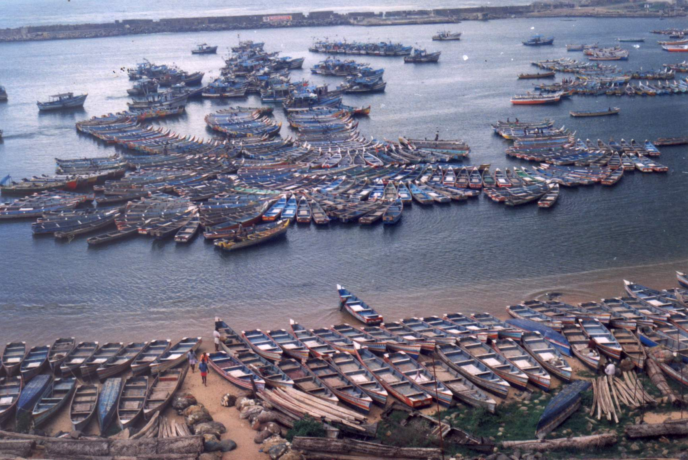
Thank You
India/SIFFS

