Slide 1
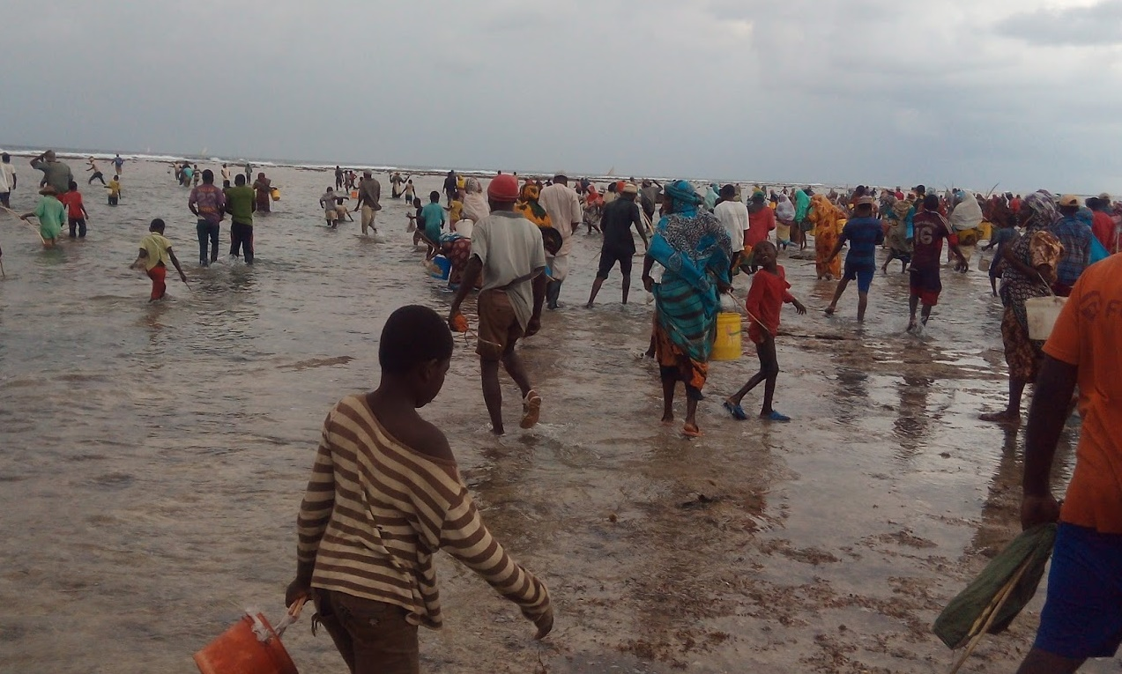
Fostering Sustainable Fisheries Management and Reducing Poverty: The Role of Social Protection of Fishers and Fishing Communities
Sebastian Mathew
International Collective in Support of Fishworkers (ICSF)
FAO Technical Workshop:
Rome, 17-18 November 2015
TANZANIA/Octopus Hunting/MWAMBAO Coastal Community Network

Slide 2
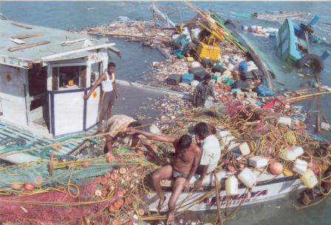
Social Protection
to conserve humans and nature affected by the deleterious action of the market
to support those affected by natural and man-made disasters as well as risks, uncertainties and vulnerabilities peculiar to fisheries and social marginalization
to eradicate poverty and to promote empowerment of fishing communities
INDIA/Ramu Aravindan

Slide 3
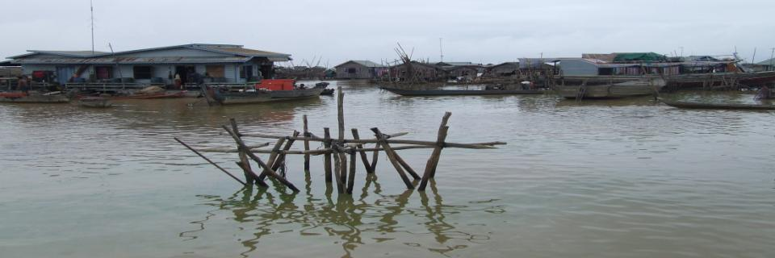
ICSF Survey: Social Protection Schemes
Interventions of relevance to the SSF subsector from the State and non-State actors to prevent, manage and overcome a defined set of risks and vulnerabilities
Adoption of legislation and policies that promote the human rights of all citizens
CAMBODIA/ICSF

Slide 4
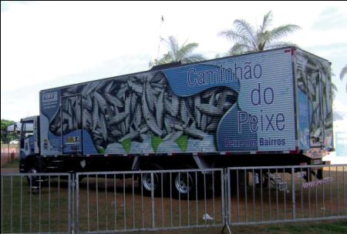
Objectives of the Survey
To document State and non-State social protection schemes in relation to:
Poverty reduction/empowerment;
Sustainable use of fisheries resources; and
Mitigation of and adaptation to natural disasters
Determine access to universal and targeted social protection schemes
Assess the effectiveness of social protection measures in relation to 1.i; 1.ii; and 1.iii
BRAZIL/Naina PIERRI

Slide 5
Questionnaire
Protective (relief from deprivation);
Preventive (to avert deprivation);
Promotive (enhance capabilities and build or strengthen resilience); and
Transformative measures (to pursue policies to address power imbalances in society as well as to secure access and use of resources) (Devereux, S. and Sabates, Wheeler, R. 2004)
INDONESIA/Mida Saragih

Slide 6
Methodology
Preparation of the questionnaire
Feedback on the questionnaire from FAO
Feedback from WFFP
Responses to questionnaire received from:
Brazil, Canada, Cambodia, Costa Rica, France, Ghana, India (Andhra Pradesh, Karnataka, Kerala, Madhya Pradesh, Maharashtra and Tamil Nadu) , Indonesia, the Netherlands, Peru, the Philippines, Saint Lucia, Senegal, Spain, South Africa, Sri Lanka, Tanzania, Thailand, Uganda and Venezuela
Compilation of the questionnaire

Slide 7
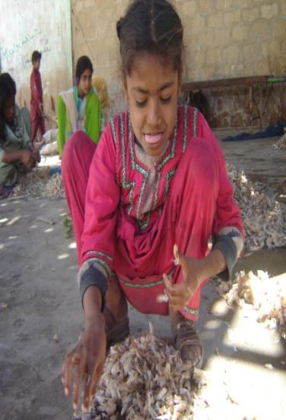
Poverty reduction/empowerment 1
Transformative measures
Legislation/policy to recognize, protect and promote the human rights of citizens
Right to social security
Enabling legislation for trade unions, coops and associations
Rights of the child
Right to food, clothing and shelter
Rights against forced labour and slavery-like conditions
Rights of women against violence and exploitation
50% countries report these measures not effectively reaching fishing communities
PAKISTAN/ PFF

Slide 8
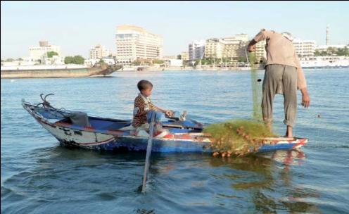
Poverty reduction/empowerment 2
Social services (universal):
Free education/waiving school fee (20 countries)
Sanitation (18 countries)
Free health care (17 countries)
Orphanages (16 countries)
Social assistance (universal):
School feeding (14 countries)
Old age pension, maternity allowance, natural disaster compensation (12 countries each)
EGYPT/Alain Le Sann

Slide 9
Poverty reduction/empowerment 3
Targeted social assistance in fisheries:
Fisheries/fish plant closure allowance; Fisheries failure assistance (7 countries each)
Fishing holiday relief assistance (4 countries)
Boat/fisher repatriation allowance (5 countries)
Assistance to families of fishers arrested/detained in other countries for fishery violations (7 countries)
Worker adjustment payments (6 countries)
Fuel subsidies (3 countries)
Sanitation (‘Total Sanitation Programme’ for fishing communities, Kerala, India)
Electricity (Theerajyothi—electrification of fishers houses, Kerala, India
Targeted social assistance , in general, have a lower coverage compared to universal social assistance schemes

Slide 10
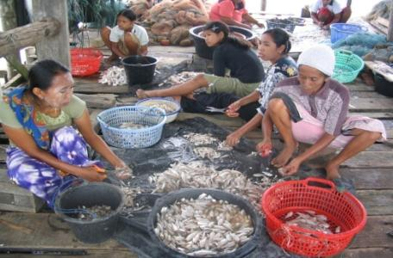
Poverty reduction/empowerment 4
Preventive Measures
Health insurance (17 countries)
Accident insurance (17 countries)
Accidental death insurance (16 countries)
Unemployment insurance (4 universal—Brazil, France, the Netherlands, South Africa; and 3 targeted at fisheries —Canada, Indonesia, Spain)
Seguro Defeso pesca, Brazil, comes under the unemployment insurance scheme
INDONESIA/Noor Aida

Slide 11
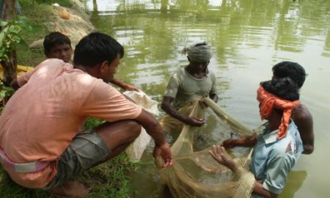
Poverty reduction/empowerment 5
Fish landing centres (13 countries)
Construction of fish ponds (13 countries)
Retraining/reskilling (12 countries)
Theera Naipunya (job-oriented training), Kerala, India
Promoting employment (8 countries)
Construction of FAD, Saint Lucia
Value addition, marketing, microenterprises (Kerala, India)
Fish processing and aquaculture, Ghana
Savings, credit and marketing (including microfinance/mobile banking)
Village Cooperative Banks (VICOBA), Tanzania
Microfinance schemes for women and black poor, South Africa
Micro-credit for small-scale fishers under PRONAF, Brazil
INDIA/Neena Koshy

Slide 12
Poverty reduction/empowerment 6
Equitable tenure rights to land and fishing grounds (10 countries)
Exclusive marine management areas for small-scale fishers and divers in Saint Lucia
Fishing grounds belong to families and traditional inheritance systems dictate tenure rights and access in Ghana
Sustainable use authorization agreement (TAUS) and marine protected areas in Brazil
Coastal fishing communities have no tenure rights in Peru (only indigenous forest communities have tenure rights); Fisheries tenure rights not recognized in South Africa; fishing communities have no legal tenure rights in Thailand; Tenure rights reform promote private interests and private investment in land and fishing grounds in Uganda

Slide 13
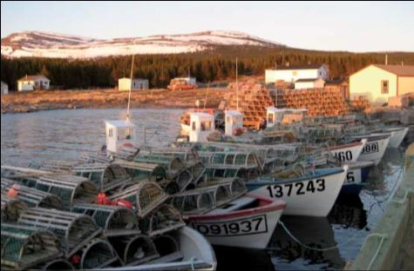
Poverty reduction/empowerment 7
Preferential access to fishing grounds to small-scale fisheries
1 naut. mile exclusion zone from trawling and other exclusion zones (RESEX) in Brazil
Fishing zones to protect the interests of traditional fishers in India (all coastal states)
3 naut. mile zone for small-scale fishing gears, Thailand
Fishing zones for small -scale fishing units in Venezuela (poorly implemented)
Up to 10 naut. miles protection zone for artisanal fishing in Peru
CANADA/Fish Food And Allied Workers Union Canada

Slide 14
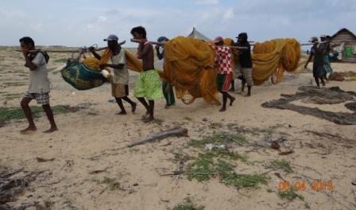
Sustainable use of fishery resources
Promotive measures
Fisheries management and conservation -marine and inland (14 countries)
Habitat protection (14 countries)
Improved post-harvest practices (13 countries)
Protecting spp. threatened with extinction (12 countries)
Use of selective gear (10 countries)
Retirement of fishing vessels (4 countries)
Mangrove afforestation (12 countries)
Coast protection (12 countries)
Membership in fishers’ coops, assns, TUs (10 countries)
SRI LANKA/NAFSO

Slide 15
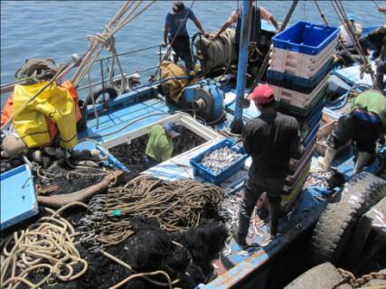
Sustainable use of fishery resources 2
Training fishers for second professional skill to alleviate pressure of overfishing (10 countries)
Alternative livelihood skills (Cambodia)
Animal and crop farming; tie and dye batik cloth printing (but unsuccessful); and aquaculture (Ghana)
Anchoveta for human consumption (Peru; but not not successful)
PERU/Santiago De La Puente

Slide 16
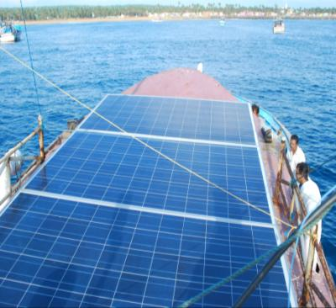
Mitigation of/adaptation to natural disasters
National climate change adaptation and mitigation policy/Disaster management
Several policies to reach carbon neutral status by 2021 (Costa Rica)
Provincial climate change policy in the pipeline (Kerala, India)
Fisheries Dept developing a sectoral climate change policy (South Africa)
Strategic programme for climate change resilience and public awareness and education strategy implementation plan (Saint Lucia)
National Climate Change Policy (Uganda)
Disaster Management Act (Sri Lanka)
INDIA/J Vincent Jain

Slide 17
Non-State Actors and Social Protection Fishery coops, NGOs, trade unions, fishers’ associations, universities
Orphanages, Maternity home
Old age home, Sanitation
Free supply of staple food
Free training to acquire alternative skills
Fisheries management and conservation
Habitat protection
Coast protection
Improved post-harvest operations
Building fish ponds
Smokeless processing
Disaster preparedness
Insurance, old age pension
Natural disaster compensation
Mangrove afforestation
Protection of charismatic species
Abstaining from destructive fishing
Retraining/reskilling
Saving, credit and marketing
Developing new marine products for the market
Establishing co-management structures
Data collection, stock monitoring
Micro-credit
Repatriation allowance
Catch and release
Fish landing centres

Slide 18
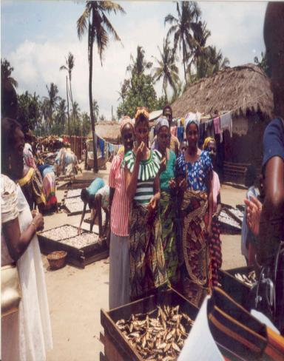
Livelihood strategies of fisheries-dependent households
Agriculture; ecotourism or fisheries-based tourism; assisting recreational fishers; housework; farm work; carpentry; masonry; handicraft; coir products; construction; gardening; animal rearing; working in factories; public works; renting out premises; home processing of fish; direct sale of fish to consumers; working as crew on larger fishing vessels; migration; illegal fishing, etc
GHANA/ICSF
Notes:
Costa Rica and “veda” period (cannot take up other work while receiving fishing holiday allowance; in general multiple livelihood strategies to supplement fisheries income; strategies differ across rural and urban divides; livelihood activities differ for men and women; gender, race and language will impact access to employment and income generating opportunities; livelihood strategy also depends on the kind of fisheries management policy (South Africa, for example, has a single species rights allocation approach). Those with high value spp might be less likely to need to supplement their incomes. In Thailand, many SS fishers would much rather remain engaged in fisheries and improve their livelihood and income from fishery. Therefore, sustainable practices and improved fisheries management are the best livelihood development options

Slide 19
Shocks/hazards the SSF communities are exposed to
Depletion of fish stocks or bad fishing season (leads to drug abuse and violence (Brazil)
Depletion of fish stocks due to unsustainable fishing operations of larger vessels (Costa Rica)
Decrease in fish production, high operating costs (Maharashtra, India)
Depletion of fish stocks; irregular income; increasing levels of poverty; high operating costs; unhealthy dependence on fish imports (Ghana)
Closure of fishing grounds and stringent restrictions on fishing leads to high risk of poverty and food insecurity, alcoholism, drug abuse, HIV, sexual violence; risk of arrest and prosecution due to fishing without recognized rights; risk of loss of life at sea; algae bloom (South Africa)
Conflicts with oil and gas industry (leads to temporary and permanent displacement from fishing ground) (Ghana, India)
Poor insurance and social security coverage (meagre income to spend on nutrition, education, health, housing, sanitation, etc.) (Ghana)
Inflation (leading to rising costs of inputs) (Venezuela)

Slide 20
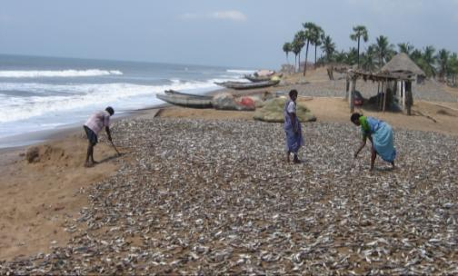
Shocks/hazards the SSF communities are exposed to (2)
Vessel breakdowns (affects the ability to replay loans)--France
Adverse weather conditions--loss of life at sea, flooding, rising coastline (South Africa)
Climate change effects--non-fishery livelihood strategies of fishers are affected, particularly in agriculture (Uganda)
Tourism and industrial development eroding tenure rights (South Africa)
Poor health and lack of health infrastructure (HIV rates continue to be much higher, e.g. Uganda)
INDIA/Venkatesh Salagrama

Slide 21
Do fisheries dependent-dependent HHs benefit from social protection?
Seguro defeso pesca steeped in corruption; little evidence of the benefits of bolsa familia for fishery HHs (Brazil)
Yes, in Costa Rica (access to health services, pension, etc) in general, but no specific studies on how the SSF sector takes advantage of social protection schemes
Yes, in Ghana. Pre-mix fuel programme, National Health Insurance Scheme and the School Feeding Programme do benefit but these are being rolled back
In South Africa, fishing communities are not targeted for specific attention unless they are very poor and rural
Vocal, organized communities (Coastal Links member communities supported by Masifundise) are getting access to a range of protective, preventive and promotive social protection measures
Yes, in Thailand
Impact on livelihood diversification, resilience, and status and management of fish stocks is not clear

Slide 22
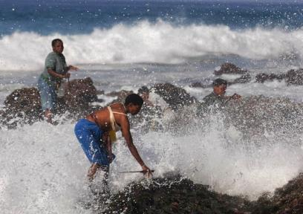
Factors preventing SP measures from reaching fishers, etc.
Bogus claimants (Brazil)
Withdrawal of the State from SP (Canada)
Poor coverage (Costa Rica);
Delays in payment (India, Ghana, Costa Rica)
Poor targeting of beneficiaries (the Philippines)
Lack of awareness of rights
(India, Costa Rica, Ghana, South Africa)
Marginalisation of small-scale fishing communities, especially in rural areas (South Africa)
Public interventions from a social development perspective have not targeted fishing communities (South Africa)
Hidden costs; arbitrary increment in premium or high premium; corruption; problems of design (Ghana, Peru)
Fisheries and environment depts do not integrate a developmental, rights-based approach as taken up by the dept of social development (South Africa)
Poor governance (artificial shortages, illegal charges, poor coordination, delay in delivery, lack of trust, etc) (Ghana, Peru, Venezuela)
Sectoral approach (Thailand)
SOUTH AFRICA/ICSF

Slide 23
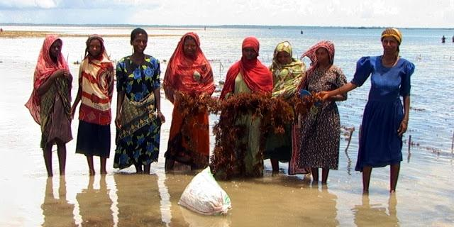
Poverty alleviation, sustainable use of fish. res. and disaster preparedness and SP
Poverty alleviation benefits from SP schemes (Tanzania, Uganda)
Links between poverty alleviation, sustainable use of fishery resources and disaster preparedness not so clear (South Africa—where overall aim of projects still focuses on protection of the environment and biodiversity; poverty alleviation is secondary)
Cash assistance under SP is too meagre for the beneficiary (India, Costa Rica)
TANZANIA/Ian Bryceson

Slide 24
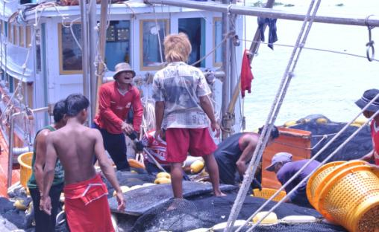
Poverty alleviation, sust. use of fish. Res. and disaster prep, and SP (2)
Need to undertake studies to find out linkages (Costa Rica)
Village Coop Bank (VICOBA) a success in providing credit but did not lead to promoting sustainable use of fisheries (Tanzania)
Social protection only provides a basic level of human security; these schemes neither reduce poverty, nor make fishery practices more sustainable (Thailand)
Disaster preparedness and sust. use of fish. res. do not benefit from social protection (Maharashtra, India)
SP meeting basic needs can complement fisheries management (Venezuela)
THAILAND/ILO
THAILAND/ILO

Slide 25
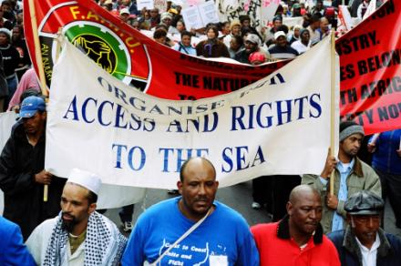
How can SP schemes in combination with fisheries interventions and enabling institutions support sustainable fisheries?
Importance of political will and having stronger organizations (Canada)
Greater coordination between line agencies (Costa Rica)
Effective delivery mechanisms, esp using direct cash transfer using IT (UIDAI, India), better targeted schemes (vulnerable and marginalized, women, etc), training (Maharashtra, India)
Enhance the capacity of the State; create employment opportunities outside fisheries to raise wages in fisheries; design a social protection programme appropriate for SSF; improve overall working conditions; involve families of fishers in fisheries management (Peru)
Livelihood diversification (South Africa, Tanzania, Peru, Uganda) and SP only a useful backup; Protect tenure rights of fishing communities (Thailand)
SOUTH AFRICA/ MASIFUNDISE
SOUTH AFRICA/ MASIFUNDISE

Slide 26
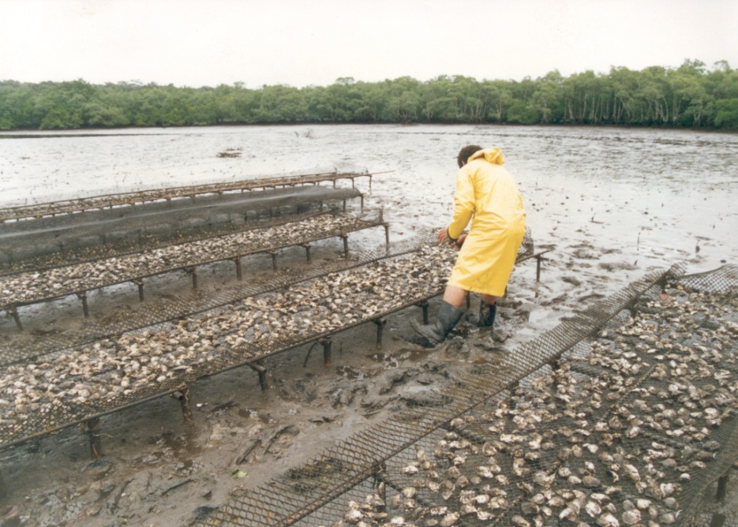
Barriers/challenges to remain as fishers and the role of SP in addressing them
Pollution, depletion (Brazil)--low impact tourism; creation of MPAs with the participation of fishing communities
Owner operator policy is the only way to protect harvesting communities (Eastern Canada)
Unfair competition from bottom trawlers (Costa Rica)—SP policies are necessary but not sufficient to address the problems confronting SSF; improve visibility of SSF; issue fishing permits; creation of responsible fishing zones
BRAZIL MPA/ Paul Seifert

Slide 27
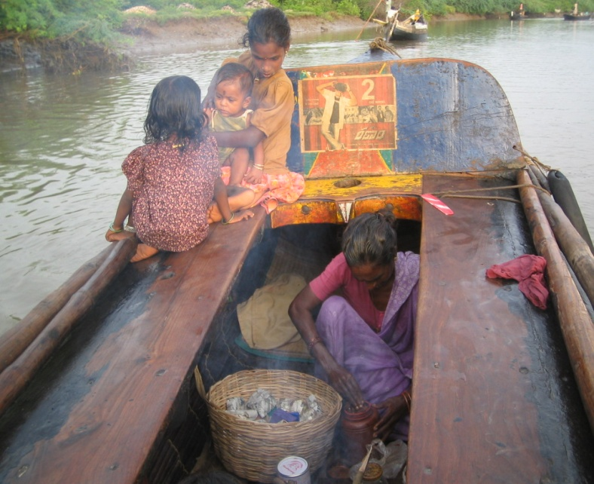
Barriers/challenges to remain as fishers and the role of SP in addressing them-2
Investment in fishing is risky; improve social protection of the small-scale investor (guaranteed revenue; provision for reconversion of vessels)
Enhance the closed season allowance (Maharashtra, India)
Secure the basic needs of fishing communities (Venezuela)
Lack of capital, weather conditions, scarcity of fishery resources, exploitative value chain, debt bondage to middlemen (Indonesia)- SP can give some relief; but focus on other economic activities, fair trade, etc.
INDIA/Prasad/ICM

Slide 28
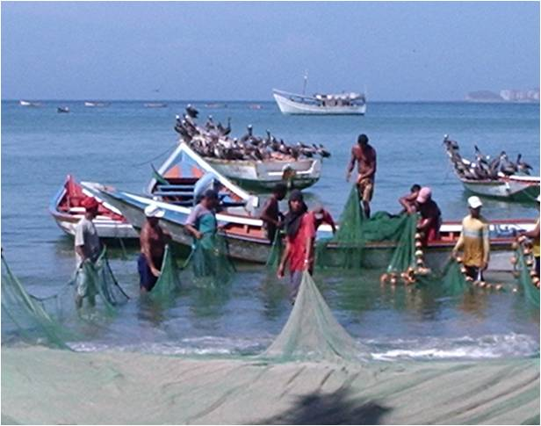
Barriers/challenges to remain as fishers and the role of SP in addressing them-3
Urbanization, acquisition of coastal land by the State, poor organization of fishers, lack of sensitivity to fisheries, variability of weather (Tanzania). Diversification into aquaculture and mariculture operations
Declining fish stocks; high cost of processing; preference to oil and gas; IUU fishing; pressure on water bodies from economic activities; lack of proper regulation and enforcement (Ghana)-social protection regime is disjointed and inadequate
VENEZUELA/Leo Walter González Cabellos

Slide 29
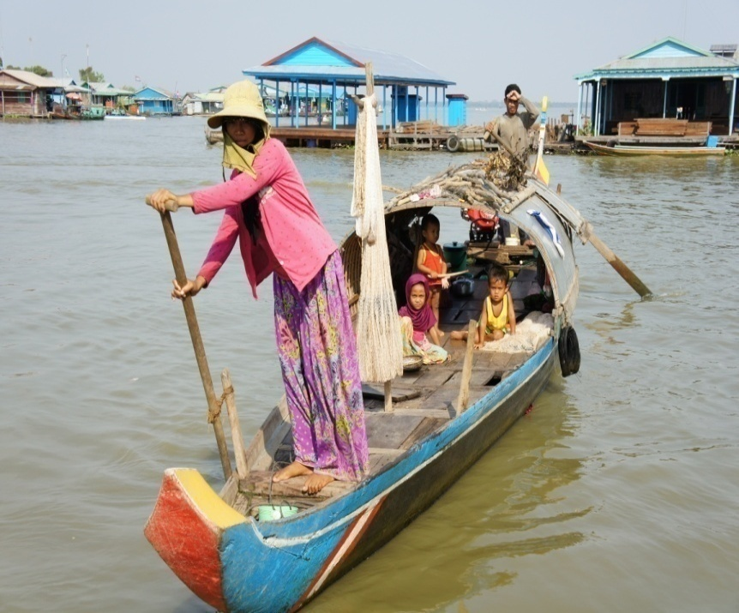
Barriers/challenges to remain as fishers and the role of SP in addressing them-4
Growing levels of poverty; increasing number of people relying on fish for food security; restrictive rights-based approach to fisheries that aim to minimize the number of resource users and maximize their profit and value addition— and exclude poor fishers.
Need to adopt a livelihood approach instead of a wealth-based approach. SP measures are grossly inadequate to overcome this barrier (South Africa)
CAMBODIA/Mina Hori

Slide 30
In conclusion
“Placing too much emphasis on social protection measures takes away from the real problem, which is that a fundamental paradigm shift is needed within the government institutions…towards small-scale communities and their plight…” (Thailand)

Slide 31
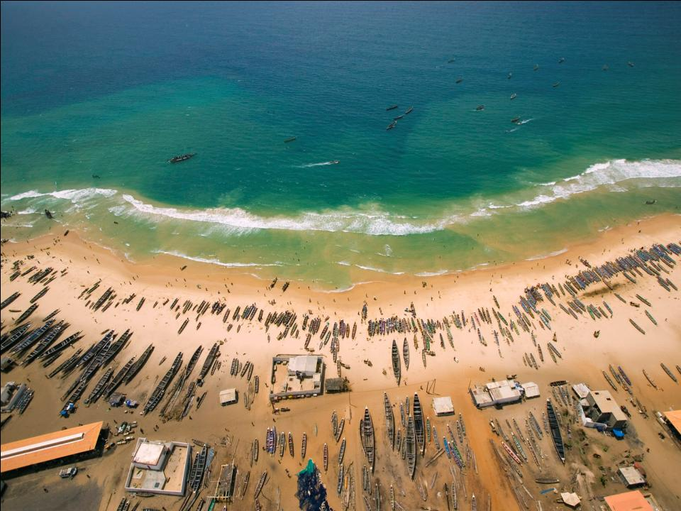
Thank You
SENEGAL/J. F Hellio and N.Van Ingen

