Slide 1
SSF Guidelines: Where do They Come From?
Sebastian Mathew
International Collective in Support of Fishworkers (ICSF)
COFI Preparatory Meeting, 10 July 2016
Città dell’altra Economia, Roma

Slide 2
Rome Conference 1984
International Conference of Fishworkers and their Supporters, Rome, 1984, after preparatory meetings in Africa, Asia and Latin America
100 fishworkers from over 34 countries participated in this conference
Held parallel to the FAO World Conference on Fisheries Management and Development (fishworkers not having formal relations with FAO were excluded from the FAO Conference)

Slide 3
Salient aspects of small-scale fisheries
“It is labour and skill intensive . . . capital and fuel-saving… its technology and mode of organization and management are well mastered by local fishing communities . . . it does not give rise to large income disparities . . . is well adapted especially to tropical aquatic ecosystems . ·. and local fishing communities often possess built -in mechanisms and rules for preventing overfishing . . it is characterized by a high degree of flexibility . . . is well integrated into small-scale marketing and distribution channels . . . The development of small-scale fisheries should not be advocated exclusively on social and welfare ground . . . (but) should be supported for economic, technical, ecological, organizational as well as social reasons.”

Slide 4
Recognition Rendered to SSF in UN Instruments
Seven paragraphs in UNCED document Agenda 21 (1992) on small-scale fishers, fishworkers, women and indigenous people
1995 UN Fish Stocks Agreement: “…avoid adverse impacts on, and ensure access to fisheries by subsistence, small-scale and artisanal fishers and women fishworkers, as well as indigenous people in developing countries…”

Slide 5
1995 CCRF
Recognizing the important contributions of artisanal and small-scale fisheries to employment, income and food security, States should protect the rights of fishers and fishworkers, particularly those engaged in subsist ence, small-scale and artisanal fisheries, to a secure and just livelihood, as well as preferential access to traditional fishing grounds and resources in the waters under their national jurisdiction (Article 6.18)

Slide 6
Preparatory Meetings for Bangkok Conference 2008
Asia: Siem Reap, Cambodia, 2007
Eastern and Southern Africa: Zanzibar, Tanzania, 2008
Latin America: Punta de Tralca, Chile, 2008

Slide 7
Bangkok Statement on Small-scale Fisheries, Oct 2008
Organized back-to-back with the Global Conference on Small-scale Fisheries, Bangkok,
106 participants from 36 countries in the CSO event
Human rights of fishing communities are indivisible and that the development of responsible and sustainable small-scale and indigenous fisheries is possible only if their political, civil, social, economic and cultural rights are addressed in an integrated manner
National governments have a legal obligation to implement international human-rights instruments. We demand that all governments take these obligations seriously and create the environment for fishing communities to fully enjoy these rights. We demand the urgent establishment of independent mechanisms to monitor, and report on, the implementation of human-rights obligations.
Called on the Committee on Fisheries (COFI) to include a specific chapter in the Code of Conduct for Responsible Fisheries (CCRF) on small-scale fisheries, recognizing the obligations of States towards them

Slide 8
COFI, 29th Session, 2011
CSOs welcomed decision of COFI 29 (2011) to develop a new international instrument on small-scale fisheries complementing the Code
CSOs welcomed the new instrument taking the form of international guidelines, rather than an international plan of action or a new Code article
CSOs welcomed the establishment and implementation of a global assistance programme

Slide 9
From Living Resources to Fishing Communities: Need for SSF Instrument
Small-scale fishing communities are vulnerable and marginalized; their women are discriminated against
Small-scale fishing communities contribution to food security and nutrition, poverty eradication, equitable development and sustainable resource utilization is not fully realized
Small-scale fishing communities are not involved in policy and decision-making processes
Small-scale fishing communities have poor access to health, education and other social services
Women in small-scale fishing communities do not participate fully in all aspects of small-scale fisheries

Slide 10
CSO Coordination Committee Formed
A CSO co-ordination group was set up in 2011 (WFFP, WFF, ICSF, IPC) to engage with the IG-SSF process
Aim was to influence the Guidelines, so they reflect aspirations of small-scale fishing communities across the world

Slide 11
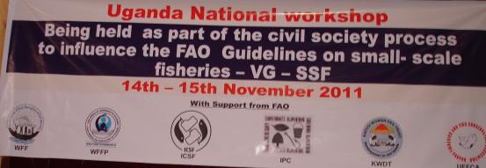
Organization of Workshops
National/ regional workshops have been organized in Asia, Africa and Latin America

Slide 12
How many Preparatory Workshops? How Many Participants?
20 national workshops and two regional workshops
Asia: workshops held in India, Sri Lanka, Pakistan, the Philippines, Thailand, Myanmar, Vietnam, Bangladesh, Indonesia and Malaysia (10 countries)
Africa: South Africa, Uganda, Tanzania, Kenya and two regional workshops for countries in West Africa (of which, one workshop focused on women)
Latin America: Brazil, Costa Rica, Nicaragua, Honduras, Panama and El Salvador (6 countries)
Over 3,000 participants in these workshops

Slide 13
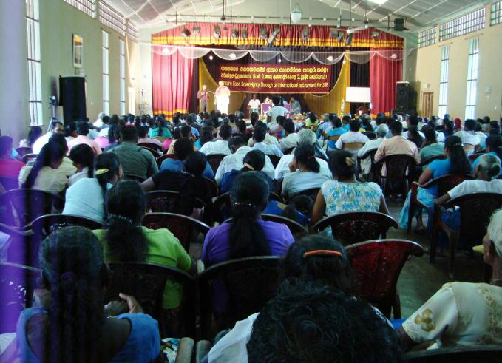
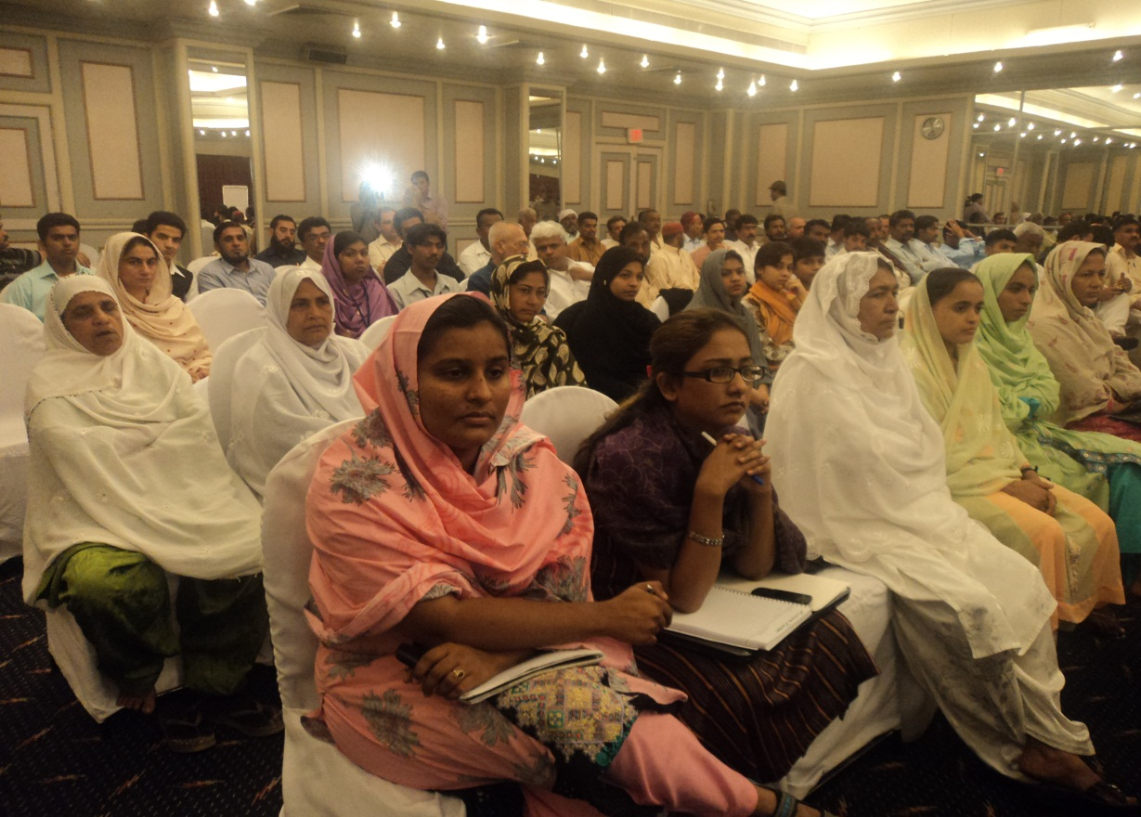
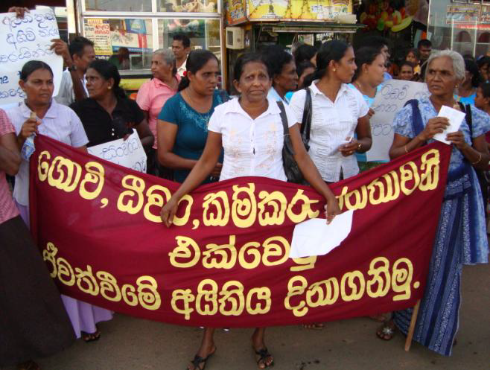
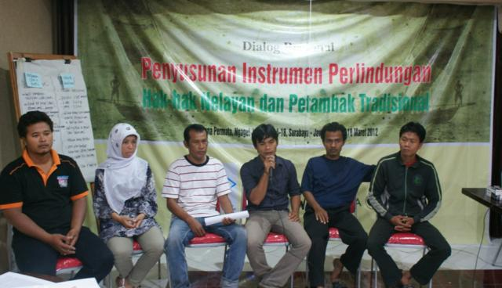

Slide 14
What were these workshops trying to do?
National-level workshops were to:
help CSOs to develop their own positions and to set out, in clear terms, what they would like to see in the SSF Guidelines
help ensure that CSOs are able to influence the proposed SSF guidelines through a bottom-up consultative process

Slide 15
Synthesis report of workshops as a basis for negotiation
Output from such workshops were synthesized and consolidated into a CSO document and finalized after circulating it for comments and suggestions
The CSO synthesis document became the basis on which CSOs negotiated—it integrated the views and aspirations of those who had participated in the process

Slide 16
Timeline: Endorsing the Guidelines
The FAO made available the zero draft of the Guidelines for comments on its website in 2012
Comments were received until end-January 2013
The Technical consultation to negotiate the content of the Guidelines was held in two sessions, May 2013 and February 2014 with active participation of CSOs
The COFI endorsed the Guidelines in 2014

Slide 17
Several Implementation Workshops
FAO-BOBLME and ICSF have organized workshops in Thailand (1), India (8+1), and Myanmar (1) early 2015;
SSNC and ICSF India (4); Regional Workshop Costa Rica (1)
IFAD-funded WFFP-WFF-CIC workshops on implementation of the SSF Guidelines in India, Brazil, Thailand and Nicaragua (2016)

Slide 18
Key lessons
Contextualizing the SSF Guidelines is important
Individual and collective human rights of fishers, fishworkers, fishing communities and indigenous peoples, both men and women, to be defended
Right to decent work of fishers and fishworkers including migrant workers in fisheries also to be defended
Interaction between various social development actors in the context of fishing communities is beneficial
Collaboration with non-fisheries institutions, especially national human rights commissions, strategic (labour, social development, migration, rights and tenure aspects, etc)
Action at local, provincial and state level needed with active participation of fishing communities

Slide 19
Thank you

