Slide 1
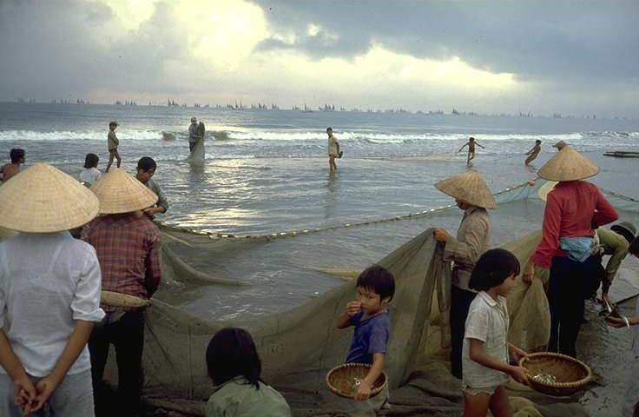
Main Challenges of Small-scale Fishers Related to Decent Work
Sebastian Mathew
International Collective in Support of Fishworkers (ICSF)
Regional Technical Seminar: Joining forces in the fisheries sector; Promoting safety, decent work and the fight against IUU fishing, 21-22 March 2018, Manila, The Philippines

Slide 2
Fisheries Sector Work (SOFIA 2008)
Fishing
Fish processing
Net and gear making
Ice production and supply
Boat construction and maintenance
Manufacturing of fish processing equipment
Packaging
Marketing
Distribution

Slide 3
Small-scale Fisheries and the Ocean Economy
Among all activities dependent on the oceans for a livelihood, small-scale fisheries is the most important—much more than tourism, shipping, oil and gas, and mining
15% of people in capture fishing and 90% in fish processing activities are women (SOFIA 2016)

Slide 4
Number of Fishers
37.9 million marine and inland fishers in 2014 (after peaking at 39.4 million in 2012)—of which 30 million fishers are in Asia (nearly 80%)
19 million fishers work on board fishing vessels (50%)
Overall employment in the sector decreased
The slight decrease in employment appears to signal a stabilization in engagement in the sector (SOFIA 2016)

Slide 5
Fishing Fleet (2016 SOFIA)
Globally, 2.94 million vessels were engine-powered (80% in Asia) and 1.7 million vessels were non-powered (2014)
2.5 million motorized fishing vessels below 12 m in length overall (LOA) (94% of inland fishing vessels are below 12 m LOA)
64,000 vessels 24 m LOA and longer
376,000 vessels between 12 m and 24 m LOA

Slide 6
Fish Production (COFI-FT, 2017)
Projected marine capture fishery production for 2017 at 91.2 million tonnes (live-weight) (same trend since 2014), which is about 53% of 172.2 million tonnes of global fish production

Slide 7
Labour Dimension of Fishing
Vast majority of fishers engaged in small-scale and artisanal fishing for employment, income and food security
Fishers work on vessels registered in states other than the fishers’ state of nationality or domicile
Fishers live on board their vessels for extended periods of time
Sharing system prevalent in fisheries lead to exclusions from laws protecting most workers
Low rates of trade union membership or lack of fishers’ organizations lead to weaker social protection and social dialogue (ILO Conditions of Work in the Fishing Sector, Report V, 2003)

Slide 8
Labour in Fisheries: Environment and Conservation Implications
Pollution, habitat degradation and loss of biodiversity reduce employment
An increasing emphasis on conservation and management of fisheries resources has implications for employment of fishers
Regulation of fishing effort and capacity reduction lead to difficulties in maintaining current levels of employment
Natural disasters can negatively impact employment

Slide 9
Decent Work: ILO and FAO
Satisfying a fair standard (OED)
“The primary goal of the ILO today is to promote opportunities for women and men to obtain decent and productive work, in conditions of freedom, equality, security and human dignity”
“Decent work is the converging focus of ILO’s four strategic objectives: the promotion of rights at work; employment; social protection; and social dialogue” (Decent Work, Report of the Director General ILO, 1999) thus, its normative aspects are broader than core labour standards
FAO Strategic Framework 2010-2019 includes promoting decent work in agriculture, forestry and fisheries, especially in rural areas
Decent work is now a global goal; an important step towards reducing poverty, and obtaining equitable, inclusive and sustainable development (High Level Segment of the UNECOSOC, 2006)
Decent work for all- UNGA Resolution 2015 Transforming Our World: the 2030 Agenda for Sustainable Development (Sustainable Development Goal 8. Promote sustained, inclusive and sustainable economic growth, full and productive employment and decent work for all

Slide 10
1. Promoting Decent Rights at Work in Small-scale Fisheries
Addressing worst forms of child labour and forced labour in fishing
Securing fair sharing arrangements
Securing gender equality and equity
Addressing discrimination against migrant fishers
Promoting the freedom of association of small-scale fishers
Protecting rights related to life, liberty, equality and dignity
Promote the role of faith-based organizations, and CSOs/NGOs in the informal fishing economy, in implementing fundamental principles and rights at work, where traditional employers’ and workers’ organizations have limited access to give a voice and empowerment to the unprotected, excluded and marginalized (ILO 2004)
Formalization can lead to the protection of (i) the right to a work agreement: (ii) right to regular periods of rest during fishing trips; (iii) right to repatriation; (iv) right to regular payment; (v) right to treatment ashore: (vi) right to safety and health; and (vii) right to social security

Slide 11
2. Promoting Decent Employment/ Self-employment
Securing access to land and fishery resources
Complying with conservation and management to protect fishing opportunities and employment
Creating employment opportunities in non-traditional avenues related to fisheries (value addition, fishery services including data collection and management, search and rescue, collaborative and cooperative research, resource management (co-management , fighting IUU fishing), etc.
Securing access to markets (value chain approach)

Slide 12
3. Decent Social Protection
Lack of universal social protection programmes (protective and preventive) and lack of targeted promotive and transformative programmes, especially to benefit the vulnerable and marginalized, including women, indigenous peoples and migrants
Poor outreach to communities who deserve to benefit from social protection
Need to enhance social protection that can promote sustainable use of fishery resources and help adapt to climate change and to mitigate impacts
Examples of seguro defeso pesca, Brazil, VICOBA, Tanzania
Need for fishers and fishworkers to organize to benefit from social protection (e.g. South Africa)

Slide 13
4. Decent Social Dialogue
Tripartite structure to influence governance in formal sectors
Consultation and participation, in general, in the informal sector seeking policy coherence, institutional coordination and collaboration
See para 10.1 of the Voluntary Guidelines for Sustainable Small-scale Fisheries in the Context of Food Security and Poverty Eradication (the SSF Guidelines)

Slide 14
Conclusion: Reducing the Decent Work Deficit
Ratify and apply the 2007 Work in Fishing Convention (No. 188) especially to benefit fishers on board both larger and smaller fishing vessels
Protect and promote all human rights
Implement the SSF Guidelines to benefit all small-scale fishers and fishworkers, as well as men, women and children in fishing communities

Slide 15
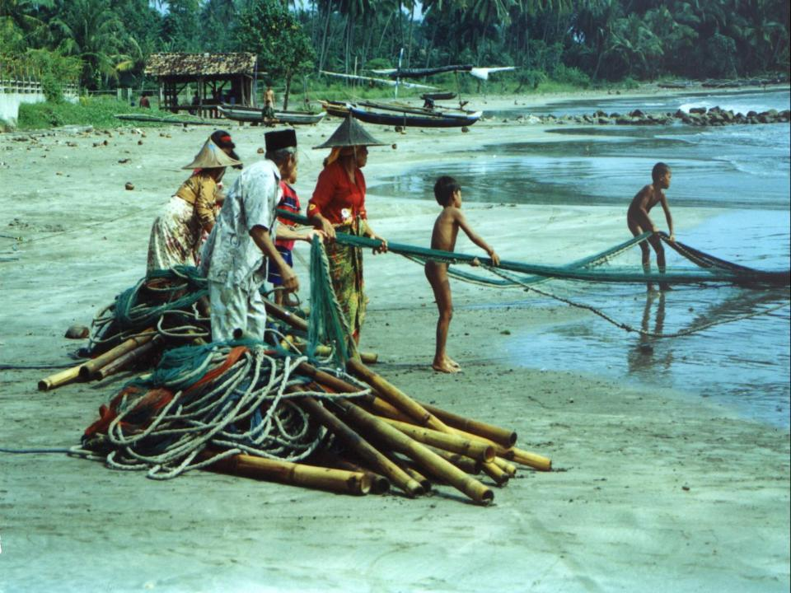
Thank You

