Slide 1
Gender mainstreaming and issues of occupational health and safety
Learnings from developing the FAO handbook on gender-equitable small-scale fisheries and governance and development
- Nilanjana Biswas
Presented at iFISH 5, St. John’s, CA, 2018

Slide 2
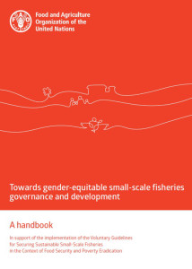

Slide 3
Gender and Occupational Health & Safety (OHS)
Two problems!
Gender issues in fisheries invisible (though women are nearly 50% of fisheries workforce)
OHS seldom raised, and usually only in relation to women’s production-based work
And a third!
Occupational health impacts of any given work are different for men and women
Wider definition of OHS needed, based on conceptual re-analysis of women’s work

Slide 4
OHS normally associated with...
Production-linked activities of women:
Waged work in industrial fish processing
Self-employed work in traditional fish processing

Slide 5
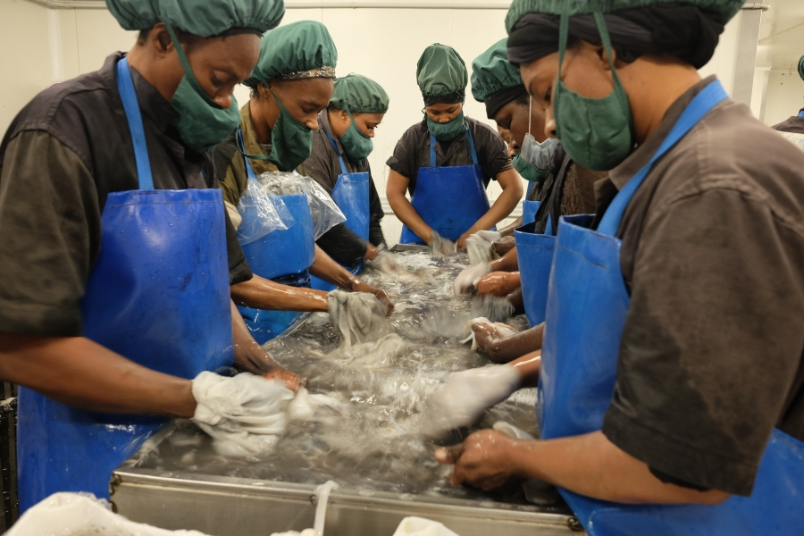
Credit: Marc Herman/PRI

Slide 6
OHS and women’s waged work in fisheries
Up to 90% of industrial fish processing workers are women
Highly vulnerable workforce
Consequently, this work is:
Informally contracted, repetitive, intense
Performed in poor working conditions
Un-/weakly regulated
Unprotected by social security/benefits
Associated with specific set of health problems
Conditions beyond immediate workplace impact OHS
Organized attempts to address workplace issues have met with some success – the case of PAFCO, Fiji

Slide 7
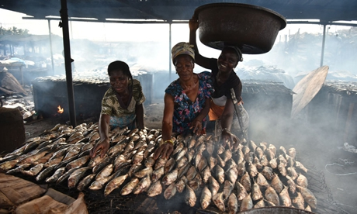
Courtesy: FAO

Slide 8
OHS issues and women’s self-employed work in fish processing
Small-scale fisheries contribute half of global fish catches and two-thirds of fish eaten by humans
Post-harvest fish production almost entirely done by women (sorting, cleaning, drying, processing)
Despite direct economic linkage, scant attention paid to working conditions
FTT-Thiaroye oven minimised post-production losses and reduced heat, smoke exposure

Slide 9
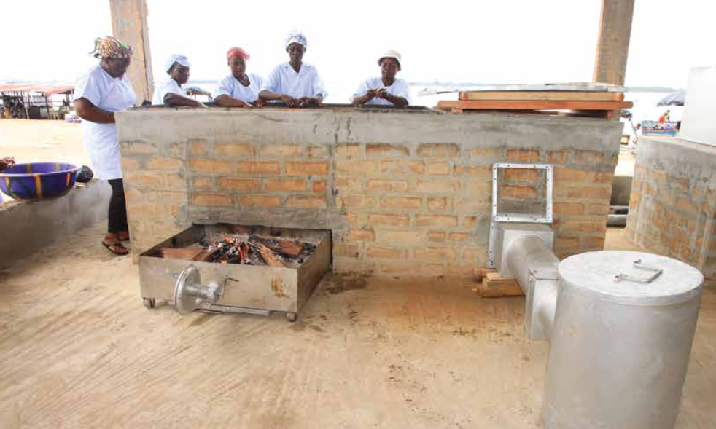
Courtesy: FAO

Slide 10
Areas of neglect in terms of OHS…
Women’s work that is vital but not directly linked to fish production:
Procurement
Transportation
Selling of fresh or processed fish

Slide 11
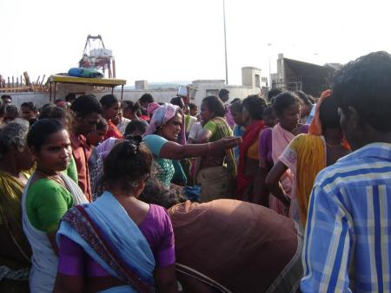
Courtesy: ICSF

Slide 12
Procurement
All small scale fishers hit by declining fish catches
But women fishers pushed out by both industry and men
Examples of impact:
Increased travel time – Case of Kerala
Increased physical/sexual violence – Case of Kenya and Zambia
Occupational hazards barely understood/studied

Slide 13
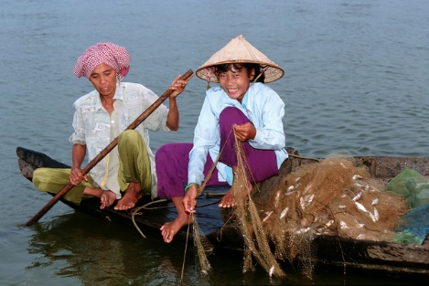
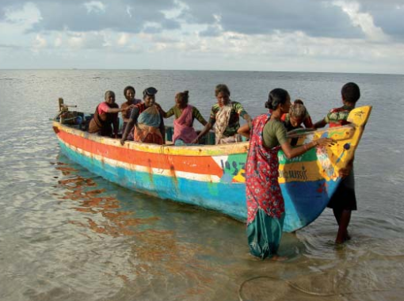
Courtesy: WorldFish
Courtesy: ICSF

Slide 14
Transporting fish
Includes:
Loading/unloading fish from boats and transport vehicles
Carrying fish to fish markets
Carrying fish for area-based or door-to-door sales
Lack of reliable, affordable transport
Musculoskeletal- and stress-related ailments hardly studied

Slide 15
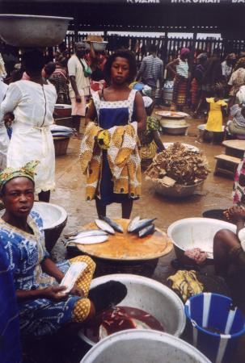
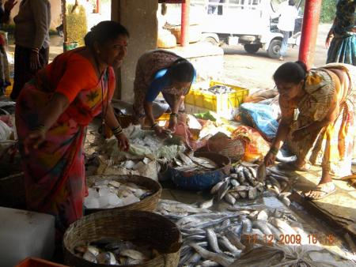
Courtesy: ICSF

Slide 16
Selling fish
Growing competition in fish trade
Increase in physical and sexual violence
Traditional selling spaces shrinking
Growing stress
Health and safety impacts uncovered by research

Slide 17
Intervening for better OHS
SSF Guidelines recommend gender mainstreaming
Some examples of effective gender mainstreaming:
Women fish vendors organization in Marol, India reclaim their fish market
Campaign for occupational health of women shellfish collectors in Bahia, Brazil
Fisherwomen in Brittany, France take the lead for “collaborative spouse” status

Slide 18
Way forward
Substantive gender mainstreaming:
Led by women
Targeting systemic, institutional change
Effective policy and regulation
Strong community and women’s organizations
Greater awareness of gender mainstreaming among OHS professionals
Wider definition of occupational health and safety based on conceptual re-analysis of women’s work

Slide 19
Thank you!

